Slide 1

Spatiotemporal Data Management and Analytics Path Finding in Road Network
By Prof Xiaofang Zhou, Dr Lei Li and Dr Pingfu Chao
University of Queensland

Slide 2
Learning Modules
 | Date | Lecture | Lecturer
1 | 22/6 | Course Introduction and RDBMS Review | Prof Xiaofang Zhou
2 | 22/6 | Introduction to Spatial Databases
3 | 23/6 | Spatial Data Organisation | Dr Lei Li
4 | 23/6 | Spatial Query Processing
5 | 24/6 | Managing Spatiotemporal Data | Dr Pingfu Chao
6 | 24/6 | Managing High Dimensional Data | Dr Lei Li
 | 25/6 | 端午节
7 | 26/6 | Advanced Topic: Route Planning in Road Networks | Dr Lei Li
8 | 26/6 | Future Trends, Course Review and Discussions | All
 |  | Revision Period
 | 9 July | Final Report Due

Slide 3
Learning Objectives
To understand basic graph concepts
To learn simple path finding algorithms
To understand how index can help improve the query efficiency

Slide 4
Outline
Background & Path Problems
Dijkstra’s Algorithms and Its Variations
Goal Directed Based Methods
Online Search Index Methods
Hop Based Methods

Slide 5
Background
Why network distance?
Euclidean distance is for “birds”, and we have to travel through some roads
Euclidean distance from UQ to Dutton Park is short
But their network distance is much longer
In real life applications , we also need a route to your destination, not just distance

Slide 6
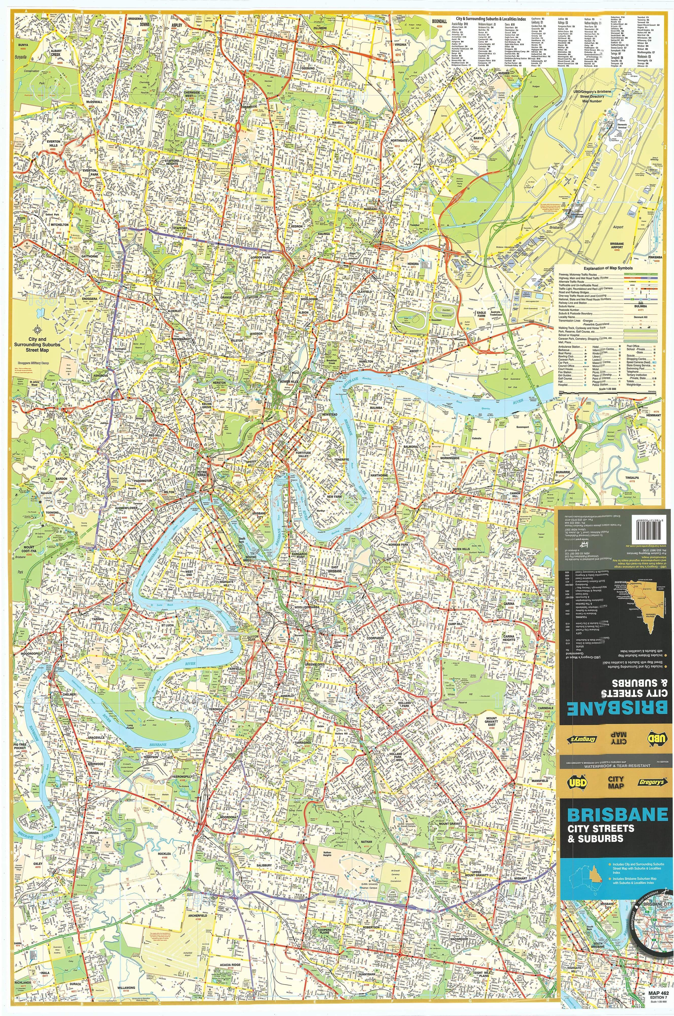
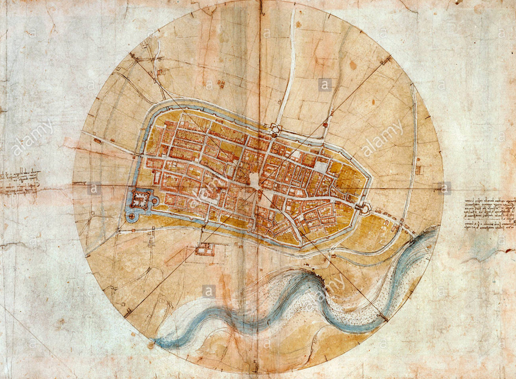

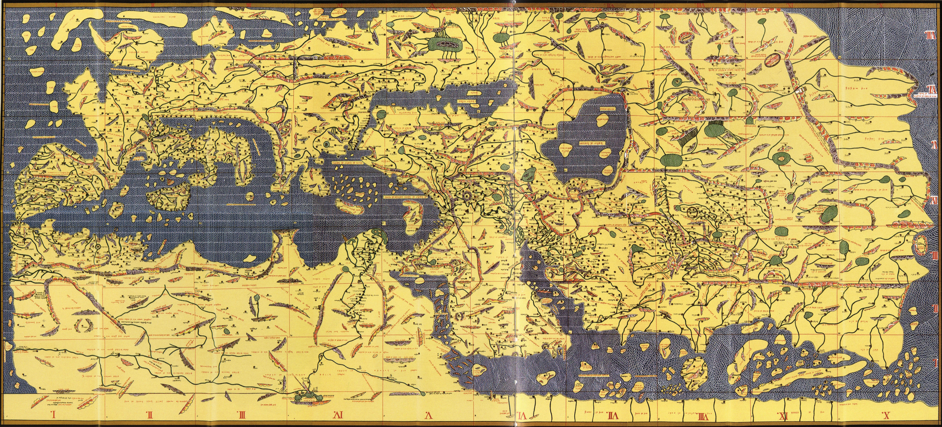
Background
Classic Maps
Districts, Roads, Streets, POIs, Bus Routes/Stops,…
Seas, Mountains, Rivers, …
Fixed Accuracy (Scale)
Basic Navigation
Approximate Distance
Approximate Direction
Approximate Current Location

Slide 7






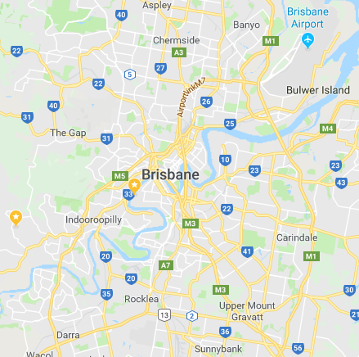
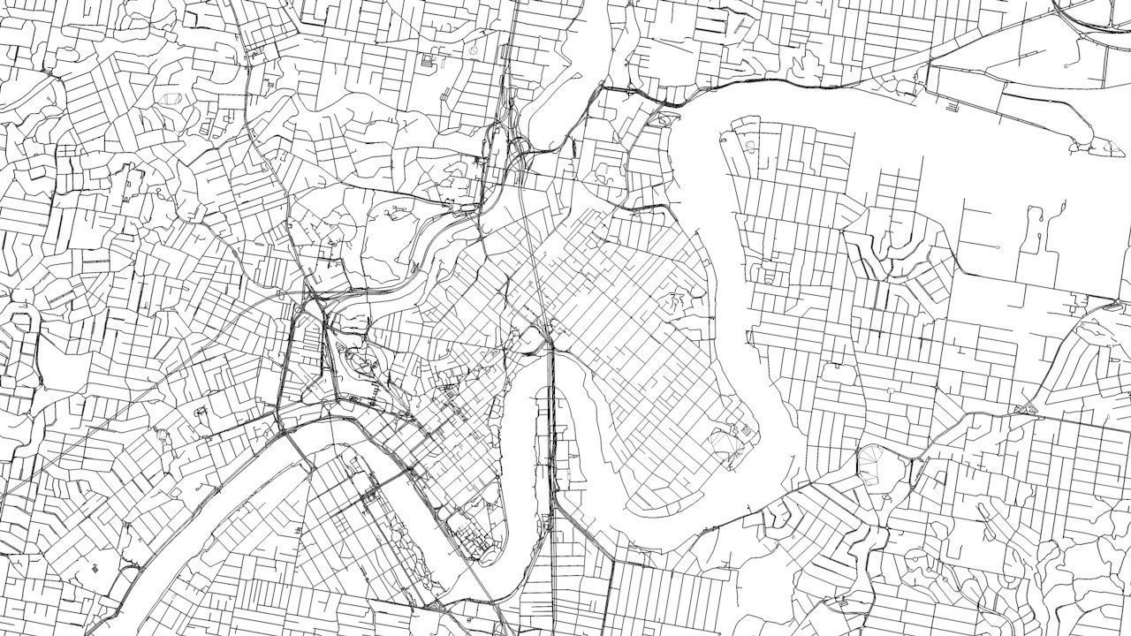
Background
Digital Maps & GPS
Any resolution
Accurate location information
Accurate distance
Traffic information
Road Network
Roads, Intersections
Path planning with algorithms

Slide 8
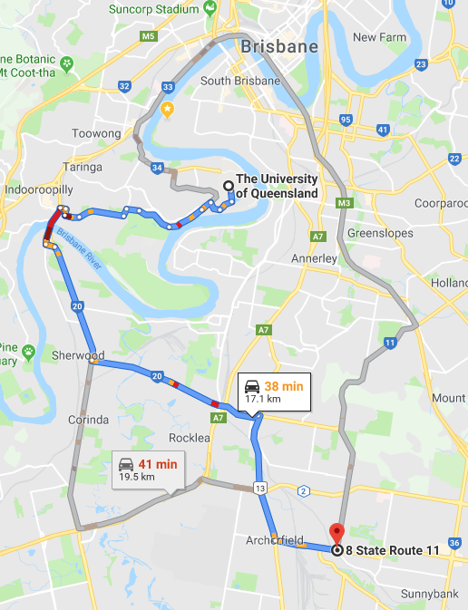
Path Problems
Examples
Shortest path from UQ to Coopers Plain
Fastest path from UQ to Coopers Plain when I depart at 5pm
Fastest path from UQ to Coopers Plain when I depart between 5pm and 7pm
Paths from Indooroopilly, City and Woolloongaba to UQ such that everybody can arrive by 10am
Fastest path from West End to Airport with toll fee under $6 (Go Between? M7?)
Earliest to arrive Coopers Plain by bus when I depart at 5pm with exchange times under 3
I want to spend at least 3 hours at UQ, 1 hour at Garden City, 1 hour at Southbank Parkland and arrive home by 9pm, what’s the schedule to waste the least time for transportation?

Slide 9
Path Problems
Examples
Shortest path from UQ to Coopers Plain
Fastest path from UQ to Coopers Plain when I depart at 5pm
Fastest path from UQ to Coopers Plain when I depart between 5pm and 7pm
Paths from Indooroopilly, City and Woolloongaba to UQ such that everybody can arrive by 10am
Fastest path from West End to Airport with toll fee under $6 (Go Between? M7?)
Earliest to arrive Coopers Plain by bus when I depart at 5pm with exchange times under 3.
I want to spend at least 3 hours at UQ, 1 hour at Garden City, 1 hour at Southbank Parkland and arrive home by 9pm, what’s the schedule to waste the least time for transportation?
Distance
Time, Fixed Departure
Time, Flexible Departure
Time, Multi-Source/Single Destination
Time, Cost Constraint
Timetable, Fixed Departure, Constraint
Time, Visiting/Staying Allowed

Slide 10
Path Problems
Dimensions
Objectives
The main value to minimize
Distance: Static value
Time: Value changes over time
Continuous / Discrete (Timetable)
Departure time
Fixed
Flexible: Choose the best departure time
Staying
Source / Destination Number
Single / Multiple
1-N, N-1, M-N, All-Pair
Objective Numbers
Single
Multiple: Constraints over the main objective

Slide 11
Path Problems
Objective | Departure Time | O/D | Constraint | Problem | Example
Static | Fixed | 1-1 / 1-N | No | Single Source Shortest Path | Shortest path from UQ to Coopers Plain
 |  | M-N |  | All Pair Shortest Path | Shortest Paths from Indooroopilly, City and Woolloongaba to UQ
 |  | 1-1 | Yes | Constraint Shortest Path | Shortest path from West End to Airport with toll fee under $6
Time - Dependent | Fixed | 1-1 / 1-N | No | Single Starting Fastest Path | Fastest path from UQ to Coopers Plain when I depart at 5pm
 | Interval | 1- 1 |  | Interval Starting Fastest Path | Fastest path from UQ to Coopers Plain when I depart between 5pm and 7pm
 |  | 1 - N |  |  | Paths from Indooroopilly, City and Woolloongaba to UQ such that everybody can arrive by 10am
 |  | 1-M-1 |  | Minimal On-Road Time Path | I want to spend at least 3 hours at UQ, 1 hour at Garden City, 1 hour at Southbank Parkland and arrive home by 9pm, what’s the schedule to waste the least time for transportation?
 |  | 1-1/1-N | Yes | Constraint Fastest Path | Fastest path from West End to Airport with toll fee under $6
Timetable - Dependent | … | … | … | Timetable Paths | Earliest to arrive Coopers Plain by bus when I depart at 5pm with exchange times under 3

Slide 12
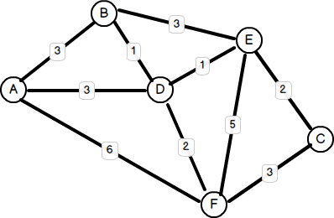
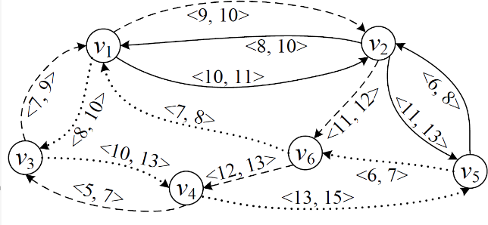
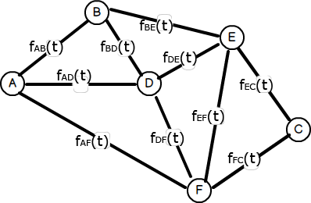
Road Network Models
Edge has only static weight
Timetable Graph
Edge has discrete Weight
Time Dependent Graph
Edge has continuous Weight
Static Graph
Shortest Path
Bus, Airplane, Train, Subway, Ferry, …
Fastest Path

Slide 13
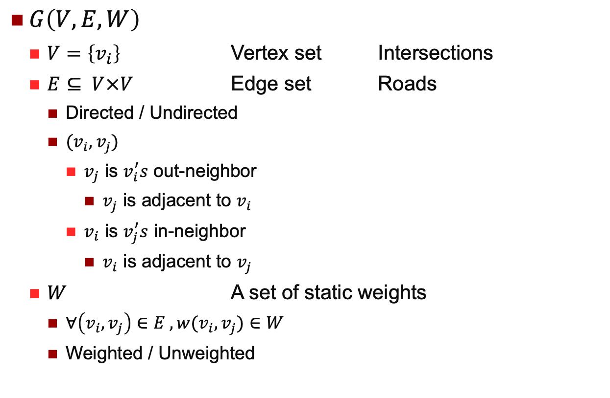
Static Graph
$G\left(V,E,W\right)$
$V=\left\{v_{i}\right\}$ Vertex set Intersections
$E⊆ V×V$ Edge set Roads
Directed / Undirected
${(v}_{i},v_{j})$
$v_{j}$ is $v_{i}^{′}s$ out-neighbor
$v_{j}$ is adjacent to $v_{i}$
$v_{i}$ is $v_{j}^{′}s$ in-neighbor
$v_{i}$ is adjacent to $v_{j}$
$W$ A set of static weights
$∀\left(v_{i},v_{j}\right)∈E ,w(v_{i},v_{j})∈W$
Weighted / Unweighted

Slide 14
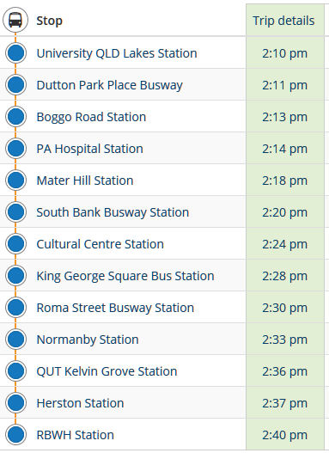
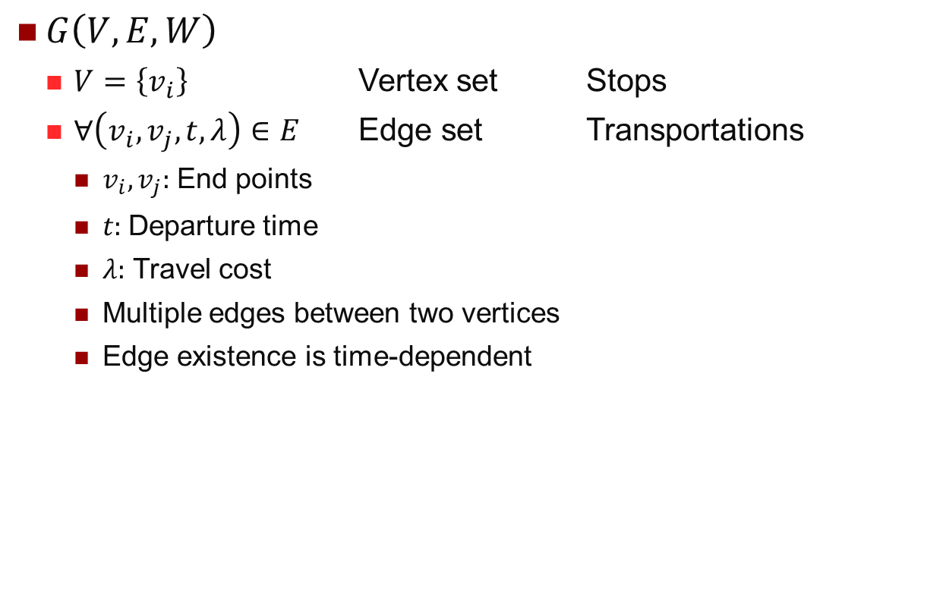
Timetable Graph
$G\left(V,E,W\right)$
$V=\left\{v_{i}\right\}$ Vertex set Stops
$∀\left(v_{i},v_{j},t,λ\right)∈E$ Edge set Transportations
$v_{i}, v_{j}:$ End points
$t:$Departure time
$λ:$ Travel cost
Multiple edges between two vertices
Edge existence is time-dependent

Slide 15
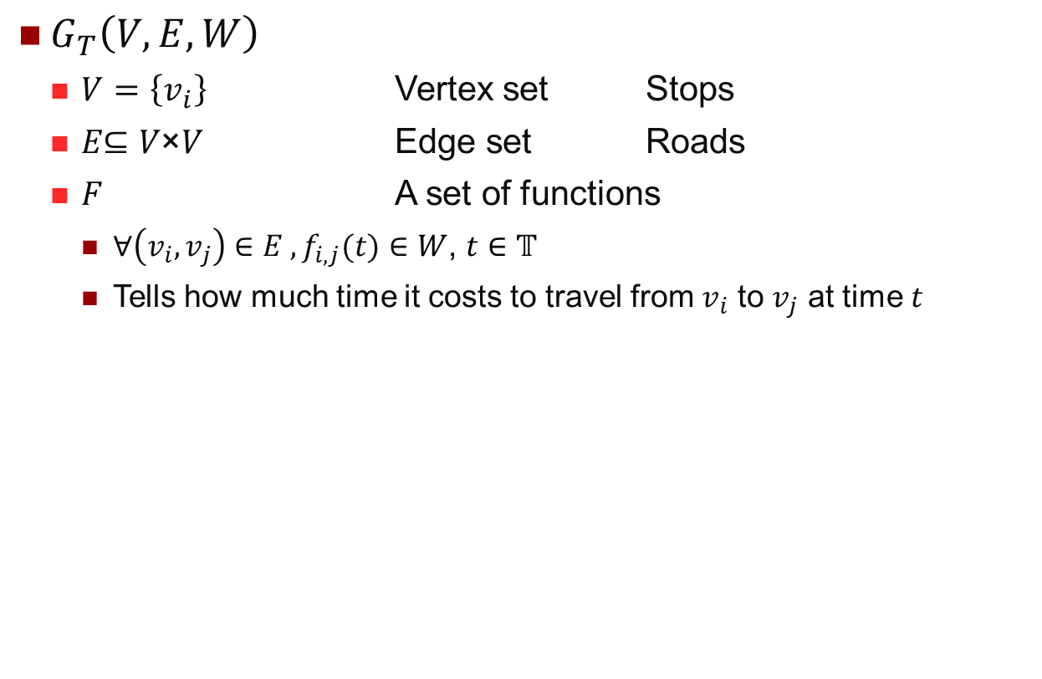
Time-Dependent Graph
$G_{T}\left(V,E,W\right)$
$V=\left\{v_{i}\right\}$ Vertex set Stops
$\text{E}\text{⊆ }\text{V}\text{×}\text{V}$ Edge set Roads
$F$ A set of functions
$∀\left(v_{i},v_{j}\right)∈E ,f_{i,j}(t)∈W$, $t∈𝕋$
Tells how much time it costs to travel from $v_{i}$ to $v_{j}$ at time $t$

Slide 16
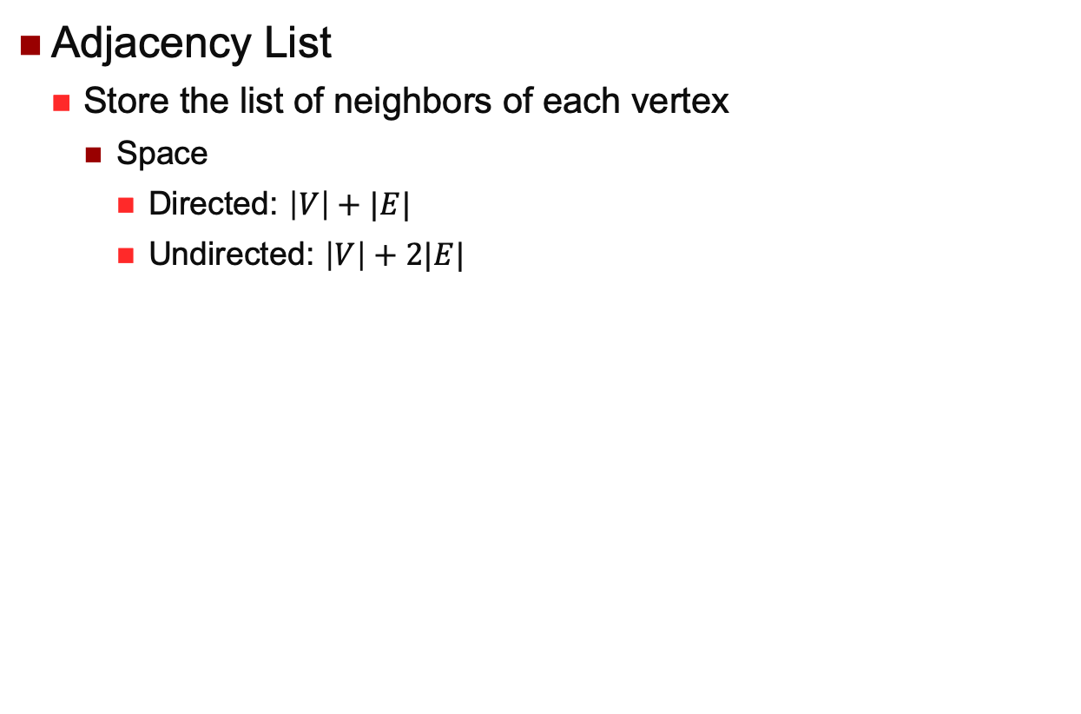
Graph Representations
Adjacency List
Store the list of neighbors of each vertex
Space
Directed: $\left|V\right|+|E|$
Undirected: $\left|V\right|+2|E|$
A
B
C
D
E
F
B | D | F
A | D | E
E | F
A | B | E | F
B | C | D | F
A | C | D | E

Slide 17
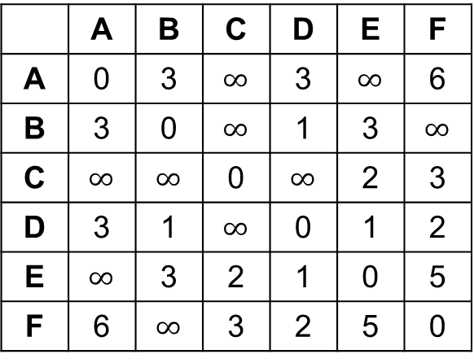
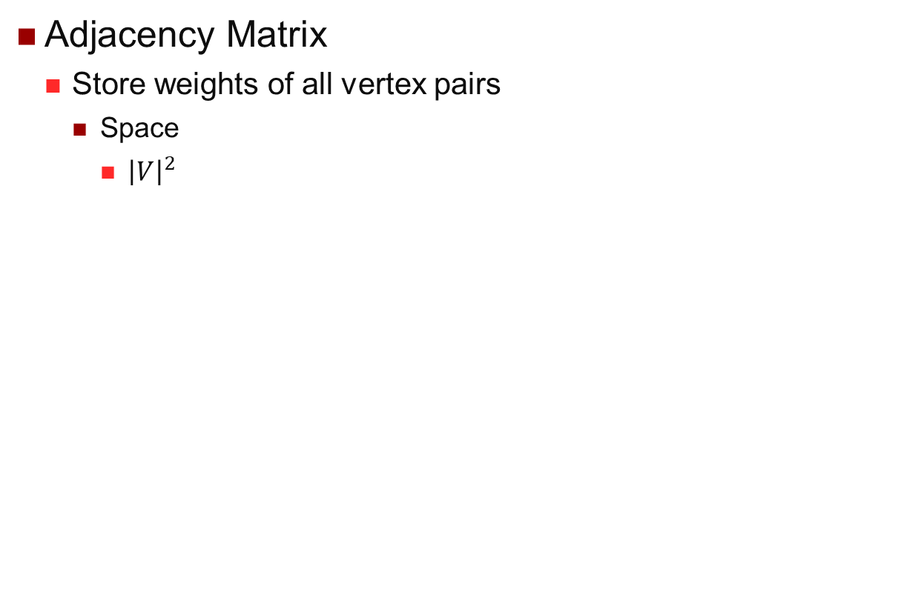
Graph Representations
Adjacency Matrix
Store weights of all vertex pairs
Space
${\left|V\right|}^{2}$
 | A | B | C | D | E | F
A | 0 | 3 | $$∞$$ | 3 | $$∞$$ | 6
B | 3 | 0 | $$∞$$ | 1 | 3 | $$∞$$
C | $$∞$$ | $$∞$$ | 0 | $$∞$$ | 2 | 3
D | 3 | 1 | $$∞$$ | 0 | 1 | 2
E | $$∞$$ | 3 | 2 | 1 | 0 | 5
F | 6 | $$∞$$ | 3 | 2 | 5 | 0

Slide 18
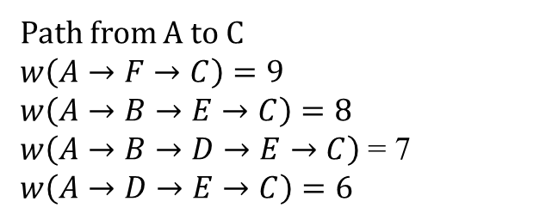
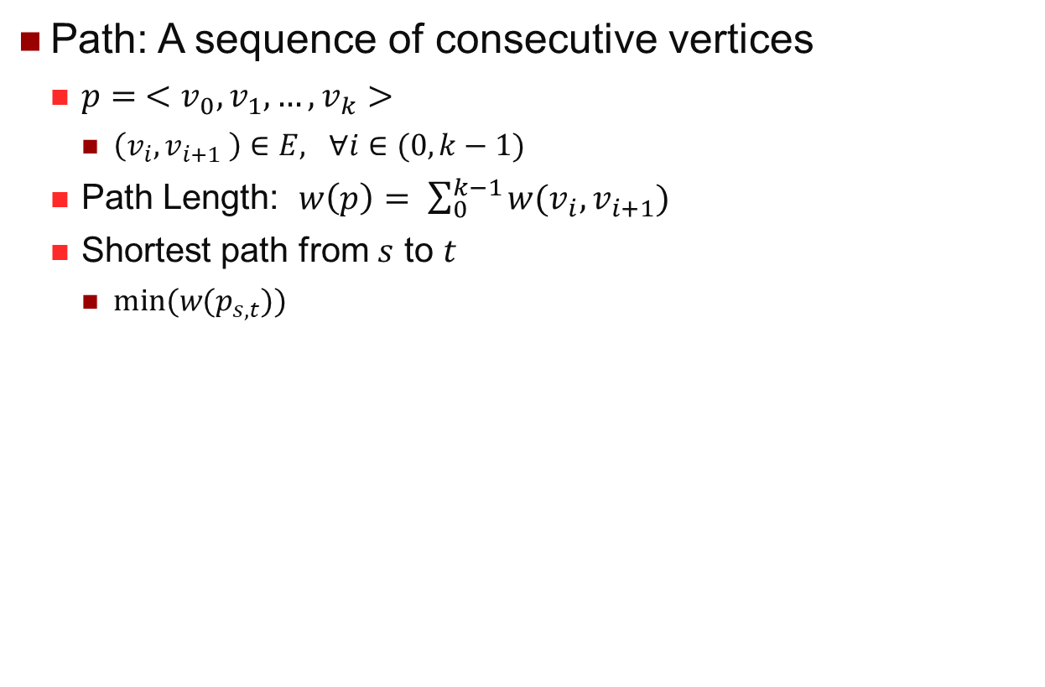
Shortest Path
Path: A sequence of consecutive vertices
$p= <v_{0},v_{1},…,v_{k}>$
$\left(v_{i},v_{i+1} \right)∈E, ∀i∈(0,k−1)$
Path Length: $w\left(p\right)= \sum_{0}^{k−1}{w(v_{i},v_{i+1})}$
Shortest path from $s$ to $t$
$min⁡(w(p_{s,t}))$
Path from A to C
$$w\left(A→F→C\right)=9$$
$$w\left(A→B→E→C\right)=8$$
$w\left(A→B→D→E→C\right)$ = 7
$$w\left(A→D→E→C\right)=6$$

Slide 19

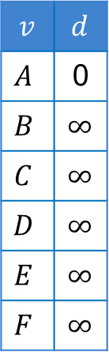


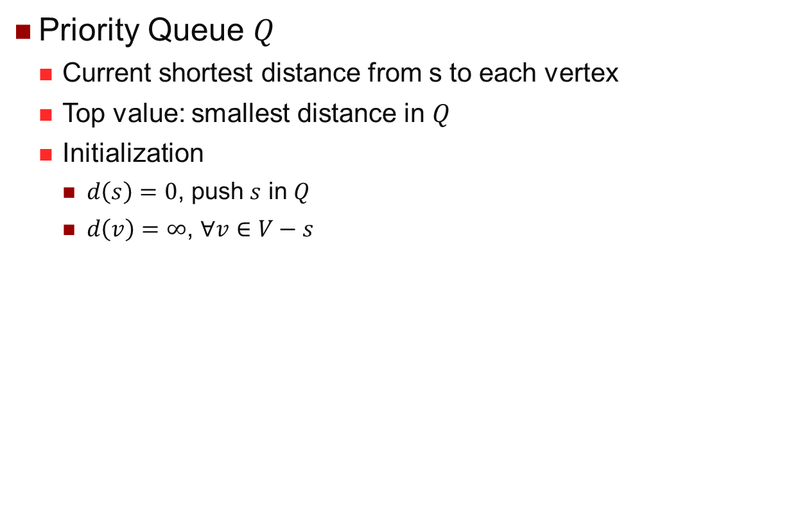


Shortest Path: Dijkstra’s Algorithm
Priority Queue $Q$
Current shortest distance from s to each vertex
Top value: smallest distance in $Q$
Initialization
$d\left(s\right)=0$, push $s$ in $Q$
$d\left(v\right)=$ $∞$, $∀v∈V−s$
V
Updated Vertex: In $Q$ with distance < $∞$
V
Top Vertex: Minimum in $Q$
V
Visited Vertex: Not in $Q,$ Found Shortest
V
Unvisited Vertex: Not in $Q$, still $∞$
$$v$$ | $$d$$
$$A$$ | 0
$$B$$ | $$∞$$
$$C$$ | $$∞$$
$$D$$ | $$∞$$
$$E$$ | $$∞$$
$$F$$ | $$∞$$
$$A(0)$$
B
3
3
E
1
1
A
3
2
D
2
5
C
6
3
F

Slide 20
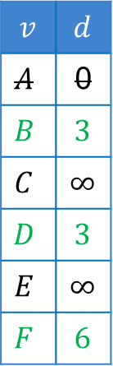
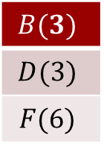
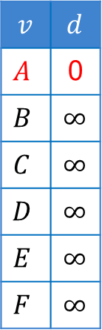

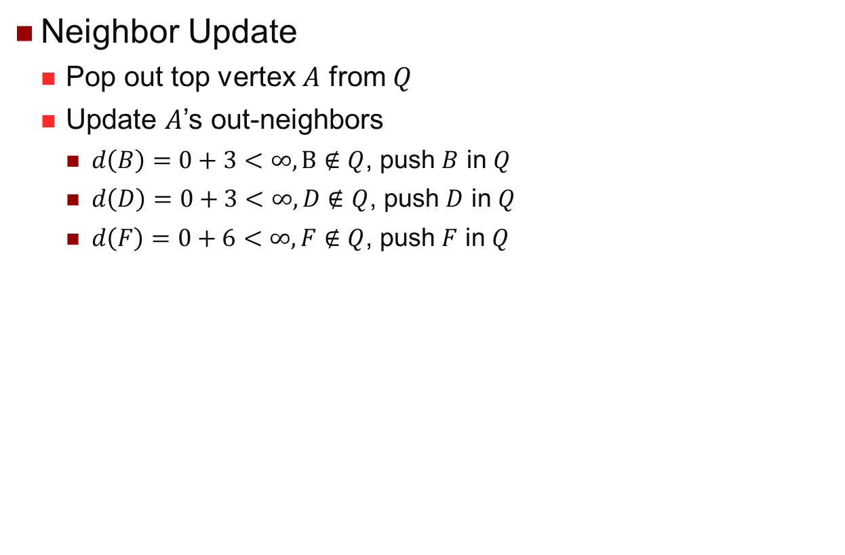
Shortest Path: Dijkstra’s Algorithm
Neighbor Update
Pop out top vertex $A$ from $Q$
Update $A$’s out-neighbors
$d\left(B\right)=0+3<∞, B∉Q$, push $B$ in $Q$
$d\left(D\right)=0+3<∞, D∉Q$, push $D$ in $Q$
$d\left(F\right)=0+6<∞, F∉Q$, push $F$ in $Q$
V
Updated Vertex: In $Q$ with distance < $∞$
V
Top Vertex: Minimum in $Q$
V
Visited Vertex: Not in $Q,$ Found Shortest
V
Unvisited Vertex: Not in $Q$, still $∞$
$$v$$ | $$d$$
$$A$$ | 0
$$B$$ | $$∞$$
$$C$$ | $$∞$$
$$D$$ | $$∞$$
$$E$$ | $$∞$$
$$F$$ | $$∞$$
$$v$$ | $$d$$
$$A$$ | 0
$$B$$ | $$3$$
$$C$$ | $$∞$$
$$D$$ | $$3$$
$$E$$ | $$∞$$
$$F$$ | $$6$$
$$A(0)$$
$$B(3)$$
$$D(3)$$
$$F(6)$$
B
3
3
E
1
1
A
3
2
D
2
5
C
6
3
F

Slide 21
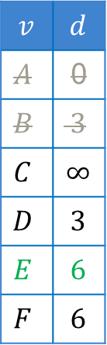
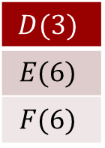
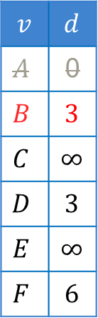
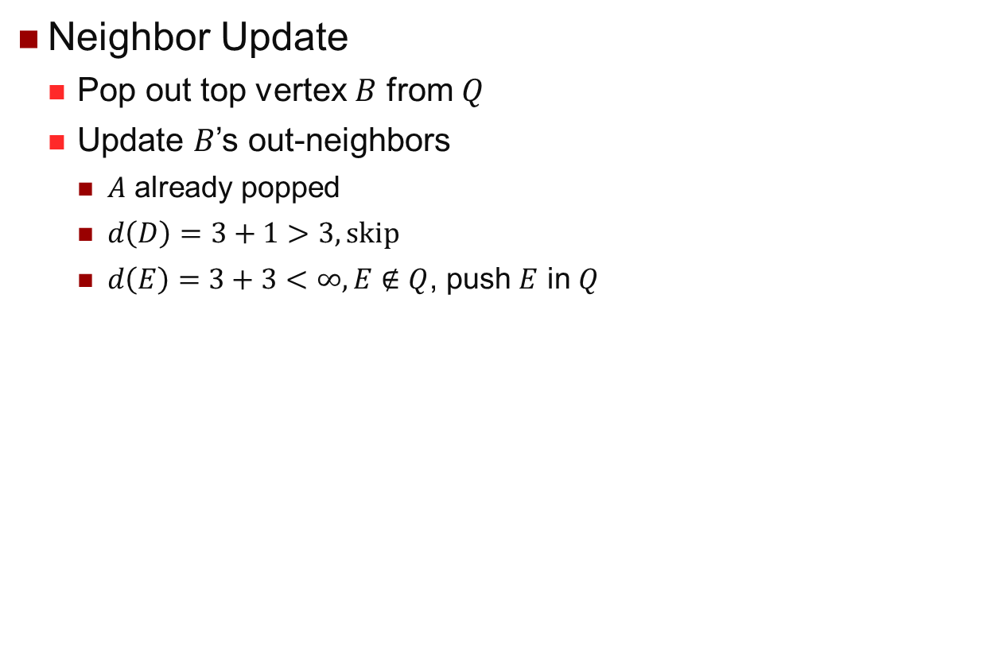
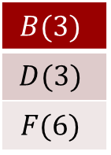
Shortest Path: Dijkstra’s Algorithm
Neighbor Update
Pop out top vertex $B$ from $Q$
Update $B$’s out-neighbors
$A$ already popped
$d\left(D\right)=3+1>3, skip$
$d\left(E\right)=3+3<∞, E∉Q$, push $E$ in $Q$
V
Updated Vertex: In $Q$ with distance < $∞$
V
Top Vertex: Minimum in $Q$
V
Visited Vertex: Not in $Q,$ Found Shortest
V
Unvisited Vertex: Not in $Q$, still $∞$
$$v$$ | $$d$$
$$A$$ | 0
$$B$$ | $$3$$
$$C$$ | $$∞$$
$$D$$ | $$3$$
$$E$$ | $$∞$$
$$F$$ | $$6$$
$$v$$ | $$d$$
$$A$$ | 0
$$B$$ | $$3$$
$$C$$ | $$∞$$
$$D$$ | $$3$$
$$E$$ | $$6$$
$$F$$ | $$6$$
$$B(3)$$
$$D(3)$$
$$F(6)$$
$$D(3)$$
$$E(6)$$
$$F(6)$$
B
3
3
E
1
1
A
3
2
D
2
5
C
6
3
F

Slide 22
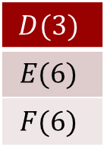
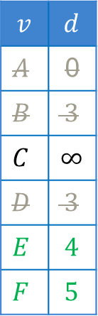
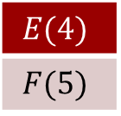
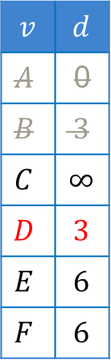
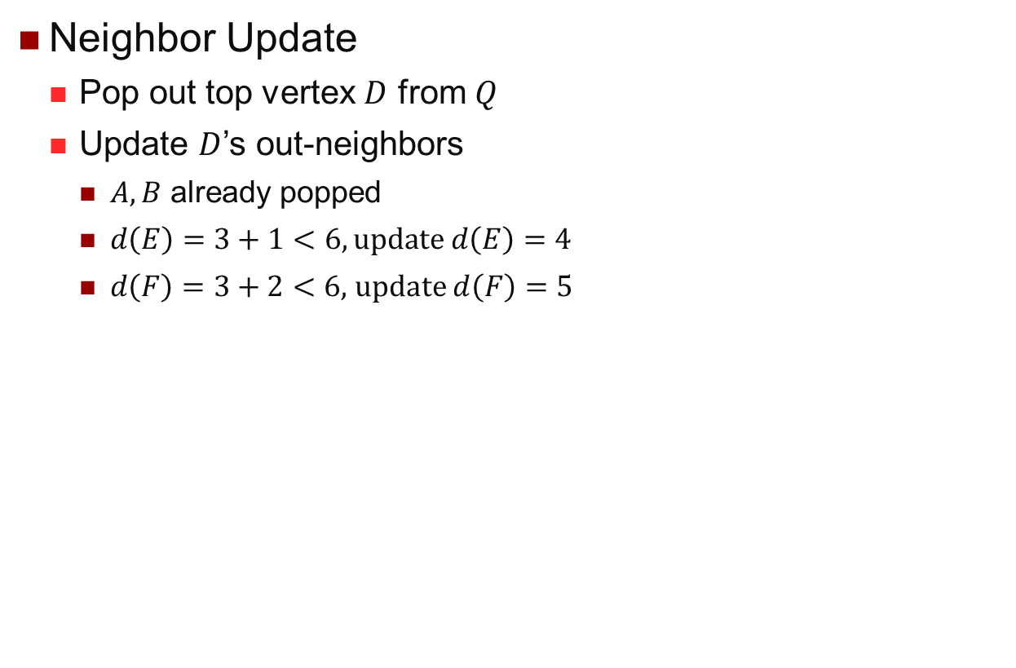
Shortest Path: Dijkstra’s Algorithm
Neighbor Update
Pop out top vertex $D$ from $Q$
Update $D$’s out-neighbors
$A,B$ already popped
$d\left(E\right)=3+1<6, update d\left(E\right)=4$
$d\left(F\right)=3+2<6,$update $d\left(F\right)=5$
V
Updated Vertex: In $Q$ with distance < $∞$
V
Top Vertex: Minimum in $Q$
V
Visited Vertex: Not in $Q,$ Found Shortest
V
Unvisited Vertex: Not in $Q$, still $∞$
$$v$$ | $$d$$
$$A$$ | 0
$$B$$ | $$3$$
$$C$$ | $$∞$$
$$D$$ | $$3$$
$$E$$ | $$6$$
$$F$$ | $$6$$
$$v$$ | $$d$$
$$A$$ | 0
$$B$$ | $$3$$
$$C$$ | $$∞$$
$$D$$ | $$3$$
$$E$$ | $$4$$
$$F$$ | $$5$$
$$D(3)$$
$$E(6)$$
$$F(6)$$
$$E(4)$$
$$F(5)$$
B
3
3
E
1
1
A
3
2
D
2
5
C
6
3
F

Slide 23
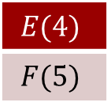
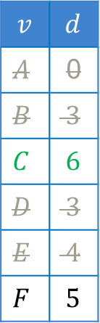
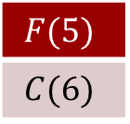
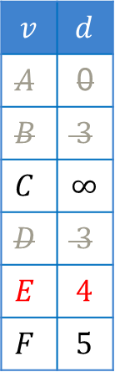
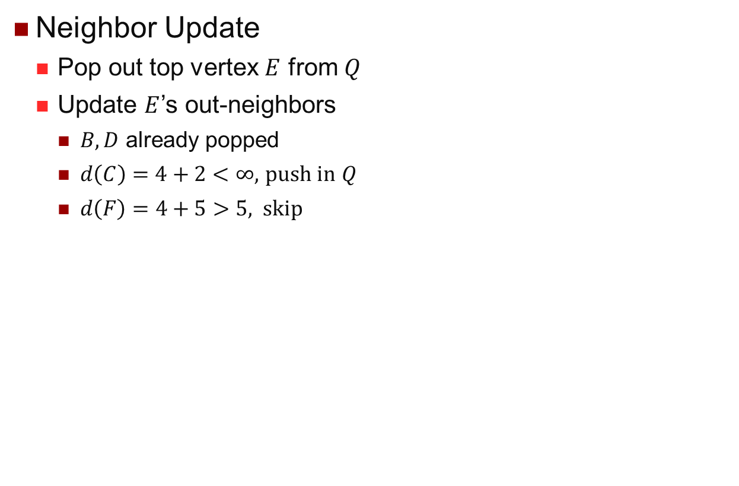
Shortest Path: Dijkstra’s Algorithm
Neighbor Update
Pop out top vertex $E$ from $Q$
Update $E$’s out-neighbors
$B,D$ already popped
$d\left(C\right)=4+2<∞,$ push in $Q$
$d\left(F\right)=4+5>5,$skip
V
Updated Vertex: In $Q$ with distance < $∞$
V
Top Vertex: Minimum in $Q$
V
Visited Vertex: Not in $Q,$ Found Shortest
V
Unvisited Vertex: Not in $Q$, still $∞$
$$v$$ | $$d$$
$$A$$ | 0
$$B$$ | $$3$$
$$C$$ | $$∞$$
$$D$$ | $$3$$
$$E$$ | $$4$$
$$F$$ | $$5$$
$$v$$ | $$d$$
$$A$$ | 0
$$B$$ | $$3$$
$$C$$ | $$6$$
$$D$$ | $$3$$
$$E$$ | $$4$$
$$F$$ | $$5$$
$$E(4)$$
$$F(5)$$
$$F(5)$$
$$C(6)$$
B
3
3
E
1
1
A
3
2
D
2
5
C
6
3
F

Slide 24
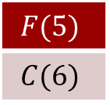
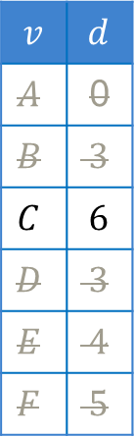

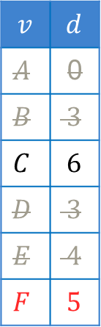
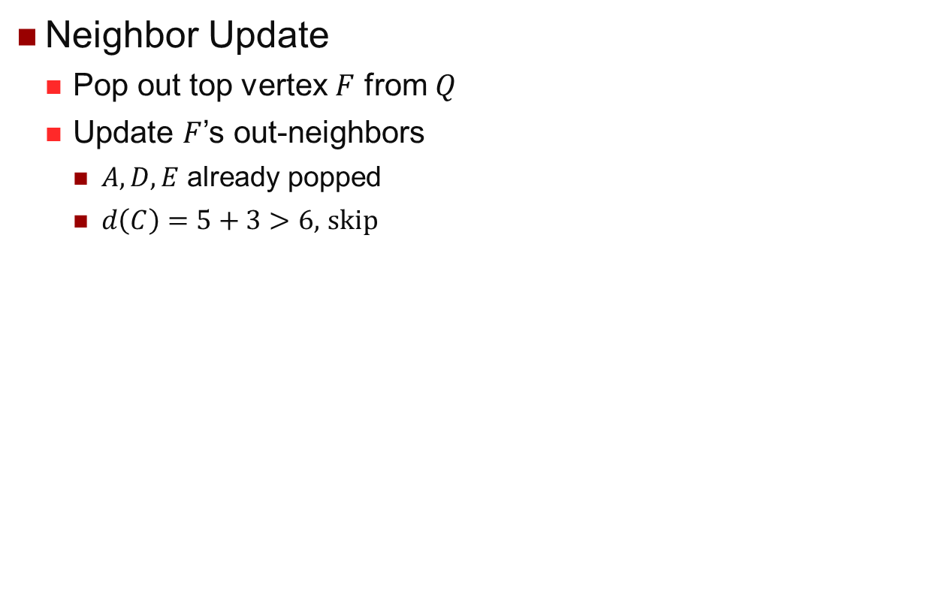
Shortest Path: Dijkstra’s Algorithm
Neighbor Update
Pop out top vertex $F$ from $Q$
Update $F$’s out-neighbors
$A,D,E$ already popped
$d\left(C\right)=5+3>6,$ skip
V
Updated Vertex: In $Q$ with distance < $∞$
V
Top Vertex: Minimum in $Q$
V
Visited Vertex: Not in $Q,$ Found Shortest
V
Unvisited Vertex: Not in $Q$, still $∞$
$$v$$ | $$d$$
$$A$$ | 0
$$B$$ | $$3$$
$$C$$ | $$6$$
$$D$$ | $$3$$
$$E$$ | $$4$$
$$F$$ | $$5$$
$$v$$ | $$d$$
$$A$$ | 0
$$B$$ | $$3$$
$$C$$ | $$6$$
$$D$$ | $$3$$
$$E$$ | $$4$$
$$F$$ | $$5$$
$$F(5)$$
$$C(6)$$
$$C(6)$$
B
3
3
E
1
1
A
3
2
D
2
5
C
6
3
F

Slide 25

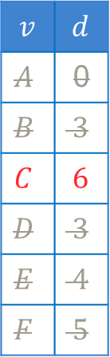
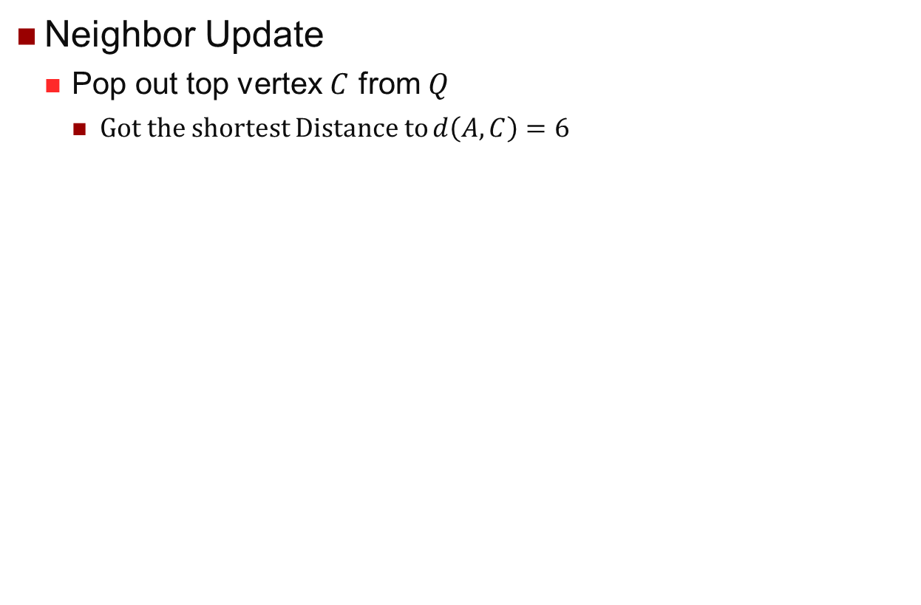
Shortest Path: Dijkstra’s Algorithm
Neighbor Update
Pop out top vertex $C$ from $Q$
Got the shortest Distance to $d\left(A,C\right)=6$
V
Updated Vertex: In $Q$ with distance < $∞$
V
Top Vertex: Minimum in $Q$
V
Visited Vertex: Not in $Q,$ Found Shortest
V
Unvisited Vertex: Not in $Q$, still $∞$
$$v$$ | $$d$$
$$A$$ | 0
$$B$$ | $$3$$
$$C$$ | $$6$$
$$D$$ | $$3$$
$$E$$ | $$4$$
$$F$$ | $$5$$
$$C(6)$$
B
3
3
E
1
1
A
3
2
D
2
5
C
6
3
F

Slide 26
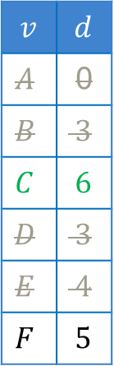

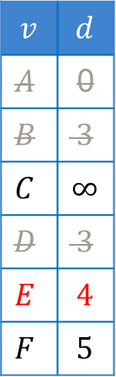
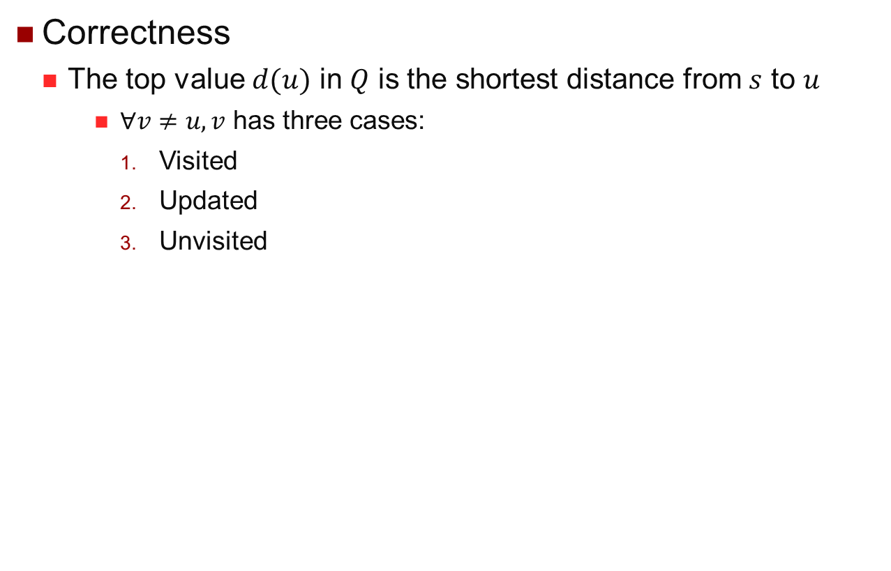
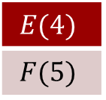
Shortest Path: Dijkstra’s Algorithm
Correctness
The top value $d(u)$ in $Q$ is the shortest distance from $s$ to $u$
$∀v≠u,v$ has three cases:
Visited
Updated
Unvisited
V
Updated Vertex: In $Q$ with distance < $∞$
V
Top Vertex: Minimum in $Q$
V
Visited Vertex: Not in $Q,$ Found Shortest
V
Unvisited Vertex: Not in $Q$, still $∞$
$$v$$ | $$d$$
$$A$$ | 0
$$B$$ | $$3$$
$$C$$ | $$∞$$
$$D$$ | $$3$$
$$E$$ | $$4$$
$$F$$ | $$5$$
$$v$$ | $$d$$
$$A$$ | 0
$$B$$ | $$3$$
$$C$$ | $$6$$
$$D$$ | $$3$$
$$E$$ | $$4$$
$$F$$ | $$5$$
$$E(4)$$
$$F(5)$$
$$F(5)$$
$$C(6)$$
3
B
3
E
1
1
A
3
2
D
2
5
C
6
3
F

Slide 27
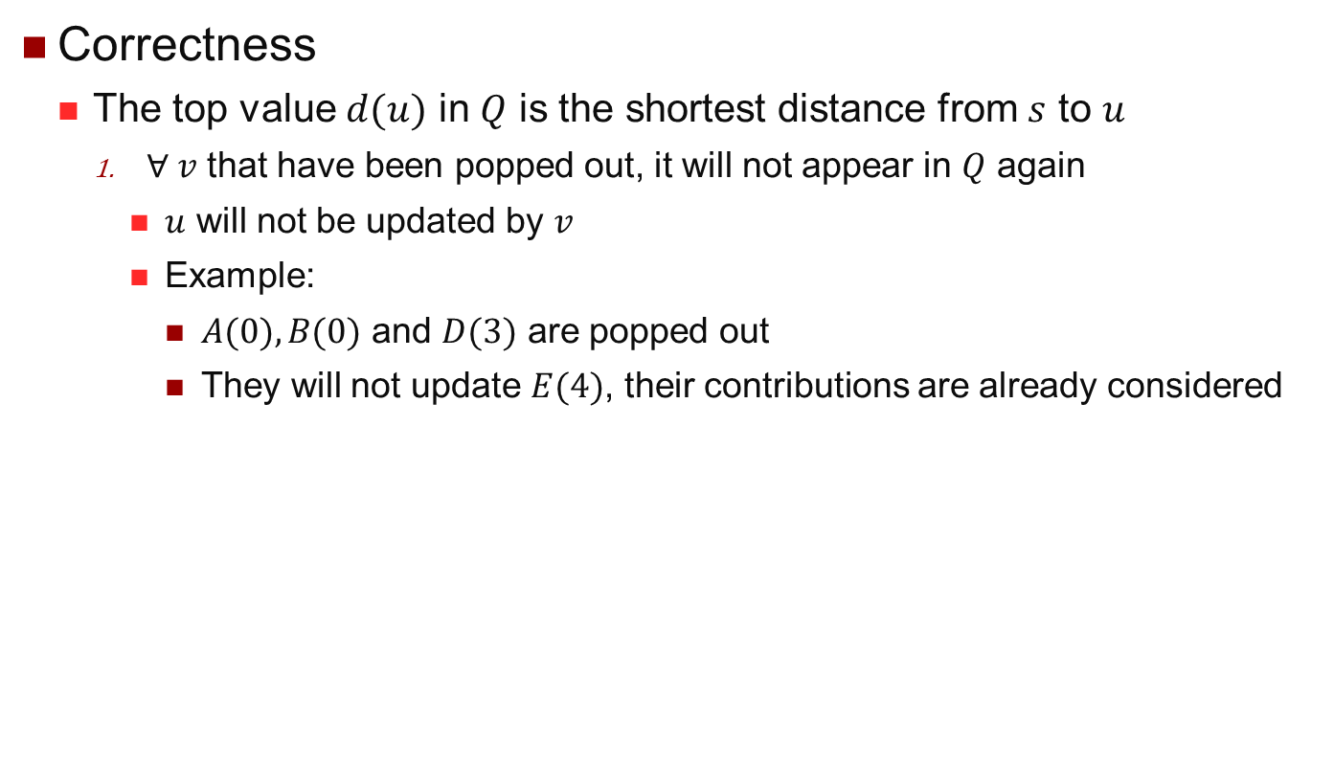

Shortest Path: Dijkstra’s Algorithm
Correctness
The top value $d(u)$ in $Q$ is the shortest distance from $s$ to $u$
$∀ v$ that have been popped out, it will not appear in $Q$ again
$u$ will not be updated by $v$
Example:
$A(0), B(0)$ and $D(3)$ are popped out
They will not update $E(4)$, their contributions are already considered
V
Visited Vertex: Not in $Q,$ Found Shortest
$$v$$ | $$d$$
$$A$$ | 0
$$B$$ | $$3$$
$$C$$ | $$∞$$
$$D$$ | $$3$$
$$E$$ | $$4$$
$$F$$ | $$5$$
$$v$$ | $$d$$
$$A$$ | 0
$$B$$ | $$3$$
$$C$$ | $$6$$
$$D$$ | $$3$$
$$E$$ | $$4$$
$$F$$ | $$5$$
$$E(4)$$
$$F(5)$$
$$F(5)$$
$$C(6)$$
3
B
3
E
1
1
A
3
2
D
2
5
C
6
3
F

Slide 28


Shortest Path: Dijkstra’s Algorithm
Correctness
The top value $d(u)$ in $Q$ is the shortest distance from $s$ to $u$
$∀ v$ $∈Q$, $d(v)≥d(u)$
$∀x∈\{(v,x)\}$, $d\left(v\right)+w\left(v,x\right)>d(u)$
Example:
$F(5)$: $F\left(5\right)>E\left(4\right) → F\left(5\right)+w>E(4)$
V
Updated Vertex: In $Q$ with distance < $∞$
$$v$$ | $$d$$
$$A$$ | 0
$$B$$ | $$3$$
$$C$$ | $$∞$$
$$D$$ | $$3$$
$$E$$ | $$4$$
$$F$$ | $$5$$
$$v$$ | $$d$$
$$A$$ | 0
$$B$$ | $$3$$
$$C$$ | $$6$$
$$D$$ | $$3$$
$$E$$ | $$4$$
$$F$$ | $$5$$
$$E(4)$$
$$F(5)$$
$$F(5)$$
$$C(6)$$
3
B
3
E
1
1
A
3
2
D
2
5
C
6
3
F

Slide 29






Shortest Path: Dijkstra’s Algorithm
Correctness
The top value $d(u)$ in $Q$ is the shortest distance from $s$ to $u$
$∀ v∉Q$ and not popped out
Will be eventually updated by $x∈Q$in the future $⇒d\left(v\right)>d(u)$
Or will remain $∞$
$E$ and $C$ are unvisited
They will be updated by $B, D$ and $F$, which are longer than $A$
V
Unvisited Vertex: Not in $Q$, still $∞$
$$v$$ | $$d$$
$$A$$ | 0
$$B$$ | $$∞$$
$$C$$ | $$∞$$
$$D$$ | $$∞$$
$$E$$ | $$∞$$
$$F$$ | $$∞$$
$$v$$ | $$d$$
$$A$$ | 0
$$B$$ | $$3$$
$$C$$ | $$∞$$
$$D$$ | $$3$$
$$E$$ | $$∞$$
$$F$$ | $$6$$
$$A(0)$$
$$B(3)$$
$$D(3)$$
$$F(6)$$
B
3
3
E
1
1
A
3
2
D
2
5
C
6
3
F

Slide 30





Shortest Path: Dijkstra’s Algorithm
Correctness
The top value $d(u)$ in $Q$ is the shortest distance from $s$ to $u$
$u^{′}s$ shortest distance is found
$D^{′}s$ shortest distance is found
When $t$ is the top, terminate search
Destination’s shortest distance is found
V
Unvisited Vertex: Not in $Q$, still $∞$
$$v$$ | $$d$$
$$A$$ | 0
$$B$$ | $$3$$
$$C$$ | $$∞$$
$$D$$ | $$3$$
$$E$$ | $$6$$
$$F$$ | $$6$$
$$v$$ | $$d$$
$$A$$ | 0
$$B$$ | $$3$$
$$C$$ | $$∞$$
$$D$$ | $$3$$
$$E$$ | $$4$$
$$F$$ | $$5$$
$$D(3)$$
$$E(6)$$
$$F(6)$$
$$E(4)$$
$$F(5)$$
B
3
3
E
1
1
A
3
2
D
2
5
C
6
3
F

Slide 31





Shortest Path: Dijkstra’s Algorithm
Complexity
Queue
Push: $|V|$ times
Deletion: $|V|$ times
Update: $|E|$ times
Operation | Operation in Dijkstra’s | Binary Heap
Insert | Push | $$O(1)$$
Delete Min | Pop | $$O(logN)$$
Decrease Key | Update | $$O(logN)$$
Binary Heap
$O\left(\left|V\right|×1+\left|V\right|×log⁡|V|+E×log⁡|V|\right)$
$O(\left(\left|V\right|+\left|E\right|\right)log⁡|V|)$
Fibonacci Heap ?
Decrease Key $O\left(1\right)$
$O(|V|log⁡|V|+|E|)$

Slide 32


Shortest Path: Dijkstra’s Algorithm
Single Source Multiple Destinations
From $s$ to $T=\{t_{1},t_{2},…,t_{n}\}$
Stop when $t_{1},t_{2},…,t_{n}$ all become visited
What we have got is the shortest distance
How to retrieve the shortest path?
V
Visited Vertex: Not in $Q,$ Found Shortest

Slide 33


Shortest Path: Dijkstra’s Algorithm
Shortest Path
Additional information
Store who updated $u$
$A$ updates $B,D$ and $F$
$$v$$ | $$d$$
$$A$$ | 0
$$B$$ | $$∞$$
$$C$$ | $$∞$$
$$D$$ | $$∞$$
$$E$$ | $$∞$$
$$F$$ | $$∞$$
$$v$$ | $$d$$
$$A$$ | 0
$$B$$ | $$3$$
$$C$$ | $$∞$$
$$D$$ | $$3$$
$$E$$ | $$∞$$
$$F$$ | $$6$$
$$v$$ | $$P$$
$$A$$
$$B$$ | $$A$$
$$C$$
$$D$$ | $$A$$
$$E$$
$$F$$ | $$A$$
B
3
3
E
1
1
A
3
2
D
2
5
C
6
3
F

Slide 34




Shortest Path: Dijkstra’s Algorithm
Shortest Path
Additional information
Store who updated $u$
$B$ updates $E$
$$v$$ | $$d$$
$$A$$ | 0
$$B$$ | $$3$$
$$C$$ | $$∞$$
$$D$$ | $$3$$
$$E$$ | $$∞$$
$$F$$ | $$6$$
$$v$$ | $$d$$
$$A$$ | 0
$$B$$ | $$3$$
$$C$$ | $$∞$$
$$D$$ | $$3$$
$$E$$ | $$6$$
$$F$$ | $$6$$
$$v$$ | $$P$$
$$A$$
$$B$$ | $$A$$
$$C$$
$$D$$ | $$A$$
$$E$$ | $$B$$
$$F$$ | $$A$$
3
B
3
E
1
1
A
3
2
D
2
5
C
6
3
F

Slide 35




Shortest Path: Dijkstra’s Algorithm
Shortest Path
Additional information
Store who updated $u$
$D$ updates $E$ and $F$
$$v$$ | $$d$$
$$A$$ | 0
$$B$$ | $$3$$
$$C$$ | $$∞$$
$$D$$ | $$3$$
$$E$$ | $$6$$
$$F$$ | $$6$$
$$v$$ | $$d$$
$$A$$ | 0
$$B$$ | $$3$$
$$C$$ | $$∞$$
$$D$$ | $$3$$
$$E$$ | $$4$$
$$F$$ | $$5$$
$$v$$ | $$P$$
$$A$$
$$B$$ | $$A$$
$$C$$
$$D$$ | $$A$$
$$E$$ | $$D$$
$$F$$ | $$D$$
B
3
3
E
1
1
A
3
2
D
2
5
C
6
3
F

Slide 36




Shortest Path: Dijkstra’s Algorithm
Shortest Path
Additional information
Store who updated $u$
$E$ updates $C$
$$v$$ | $$d$$
$$A$$ | 0
$$B$$ | $$3$$
$$C$$ | $$∞$$
$$D$$ | $$3$$
$$E$$ | $$4$$
$$F$$ | $$5$$
$$v$$ | $$d$$
$$A$$ | 0
$$B$$ | $$3$$
$$C$$ | $$6$$
$$D$$ | $$3$$
$$E$$ | $$4$$
$$F$$ | $$5$$
$$v$$ | $$P$$
$$A$$
$$B$$ | $$A$$
$$C$$ | $$E$$
$$D$$ | $$A$$
$$E$$ | $$D$$
$$F$$ | $$D$$
B
3
3
E
1
1
A
3
2
D
2
5
C
6
3
F

Slide 37




Shortest Path: Dijkstra’s Algorithm
Shortest Path
Additional information
Store who updated $u$
$F$ updates nothing
$$v$$ | $$d$$
$$A$$ | 0
$$B$$ | $$3$$
$$C$$ | $$6$$
$$D$$ | $$3$$
$$E$$ | $$4$$
$$F$$ | $$5$$
$$v$$ | $$d$$
$$A$$ | 0
$$B$$ | $$3$$
$$C$$ | $$6$$
$$D$$ | $$3$$
$$E$$ | $$4$$
$$F$$ | $$5$$
$$v$$ | $$P$$
$$A$$
$$B$$ | $$A$$
$$C$$ | $$E$$
$$D$$ | $$A$$
$$E$$ | $$D$$
$$F$$ | $$D$$
B
3
3
E
1
1
A
3
2
D
2
5
C
6
3
F

Slide 38


Shortest Path: Dijkstra’s Algorithm
Shortest Path
Traverse back from $C$
$C←E←D←A$
$$v$$ | $$P$$
$$A$$
$$B$$ | $$A$$
$$C$$ | $$E$$
$$D$$ | $$A$$
$$E$$ | $$D$$
$$F$$ | $$D$$
3
3
B
3
E
1
1
A
3
2
2
1
D
2
5
C
6
3
F

Slide 39





Shortest Path: Bi-Dijkstra’s
Dijkstra’s Search Space
Expand as a circle
Most of the search space is useless
Bi-Directional Dijkstra’s
Replace a large circle with 2 smaller ones
$$s$$
$$t$$

Slide 40

Shortest Path: Bi-Dijkstra’s
Forward Search
From $s$ with distance $d_{f}(u)$
Visit out-neighbors (original graph)
Backward Search
From $t$ with distance $d_{b}(v)$
Visit in-neighbors (reverse graph)
Termination
$u$is popped both forwardly and backwardly
$d\left(s,t\right)=d_{f}\left(u\right)+d_{b}(u)$
NO !

Slide 41

















Shortest Path: Bi-Dijkstra’s
Example
Forward Search
$u$ has been popped out
$d_{f}\left(u\right)=50$
$x$ is updated
$d_{f}\left(x\right)=56$
Current top is $v$
$d_{f}\left(v\right)=55$
$$u$$
$$5$$
$$v$$
$$4$$
$$50$$
$$6$$
$$x$$
$$t$$
$$s$$
$$40$$
$$u(50)$$
$$v(55)$$
$$x(56)$$
Forward Settled: $u, v$
Backward Settled: $v,x$
$d_{f}\left(v\right)+d_{b}\left(v\right)=55+44=99$
$d_{u}\left(u\right)+{w\left(u,x\right)+d}_{b}\left(x\right)$
= 50 + 6 + 40 = 96 < 99
Backward Search
$v$ has been popped out
$d_{b}\left(v\right)=44$
$x$ has been popped out
$d_{b}\left(x\right)=40$
$u$has been updated
$d_{b}\left(u\right)=46$
$$x(40)$$
$$v(44)$$
$$u(46)$$

Slide 42







Shortest Path: Bi-Dijkstra’s
Maintain $μ$ as the best distance so far
$μ=∞$
Forward Search
$u$ is top of $Q_{f}$
$∀x∈\{\left(u,x\right)\}$ and $d_{b}(x)≠∞$
$μ=min\left(μ,d_{f}\left(u\right)+w\left(u,x\right){+d}_{b}\left(x\right)\right)$
Backward Search
$v$ is top of $Q_{b}$
$∀x∈\{\left(x,v\right)\}$ and $d_{f}(x)≠∞$
$μ=min\left(μ,d_{f}\left(x\right)+w\left(x,v\right){+d}_{b}\left(v\right)\right)$
Termination
$d_{f}\left(top\right)+d_{b}(top)≥μ$
$$u,d_{f}(u)$$
$$v,d_{b}(v)$$
$$x$$
$$t$$
$$s$$
$$u,d_{f}(u)$$
$$x$$
$$v,d_{b}(v)$$
$$t$$
$$s$$

Slide 43

Goal Directed: A* Algorithm
Search Space
Still circles
Heuristic
From City to Mt Coot-tha
Search towards New Farm?
Search towards Bowen Hills?
Search towards Annerley?
Search towards Mt Coot-tha!
$$s$$
$$t$$

Slide 44


Goal Directed: A* Algorithm
Search Space
How to “drag” the search towards the destination
Heuristic
$π\left(u\right):$ Estimate distance from $u$ to $t$
The vertices nearer to destination are more important!
Toowong > Milton > Fortitude Valley > New Farm > Annerley >…
$π\left(Toowong\right)<$ $π\left(Milton\right)<π\left(\text{Fortitude} \text{Valley}\right)<…$
$$s$$
$$t$$

Slide 45


Goal Directed: A* Algorithm
Search Space
How to “drag” the search towards the destination
Distance Importance
$Dijkstra^{′}s$
$d\left(city, Toowong\right)$
$d\left(city, Milton\right)$
$d\left(city, New Farm\right)$
$d\left(city, Fortitude Valley\right)$
We should try Toowong and Milton earlier than FV and New Farm
$$s$$
$$t$$
$Hueristic$
$d\left(city, Toowong\right)+π(Toowong)$
$d\left(city, Milton\right)+π(Milton)$
$d\left(city, Fortitude Valley\right)+π(FV)$
$d\left(city, New Farm\right)+π(New Farm)$

Slide 46









Goal Directed: A* Algorithm
Search Space
How to “drag” the search towards the destination
Heuristic
$π\left(u\right):$ Estimate distance from $u$ to $t$
If $d\left(s,u\right)+π\left(u\right)<d\left(s,v\right)+π\left(v\right)$
$d\left(city, Toowong\right)$ > $d\left(city, New Farm\right)$
$d\left(city, Toowong\right)+π(Toowong)$ <$d\left(city, New Farm\right)+π(New Farm)$
We should visit $u$ earlier than $v$ even if $d\left(s,u\right)>d\left(s,v\right)$
$$s$$
$$t$$
$$u$$
$$d\left(s,u\right)$$
$$π\left(u\right)$$
$$s$$
$$t$$
$$d\left(s,v\right)$$
$$π\left(v\right)$$
$$v$$

Slide 47



Goal Directed: A* Algorithm
Search Space
How to “drag” the search towards the destination
Heuristic
$π\left(u\right):$ Estimate distance from $u$ to $t$
Estimation in road network
Euclidean Distance
Convert the longitude/latitude to distance
Shortest straight line distance between 2 vertices
Always not longer than the roads/paths
$$s$$
$$t$$

Slide 48










Goal Directed: A* Algorithm
Dijkstra’s-like Search
Different key
$d_{π}\left(u\right)=d\left(s,u\right)+π(u)$ as key in $Q$
Update top vertex $u$’s neighbor $v$
$d\left(s,v\right)=min⁡(d\left(s,v\right) , d\left(s,u\right)+w(u,v))$
Update with $d_{π}\left(v\right)=d\left(s,v\right)+π\left(v\right)$
Distance information is also preserved
Terminate
When $t$ is the top of $Q$
$$u$$
$$w\left(u,v\right)$$
$$v$$
$$d\left(s,u\right)$$
$$π\left(v\right)$$
$$π\left(u\right)$$
$$t$$
$$s$$
$$v$$ | $$d$$
$$v_{0}$$ | $${d(s,v}_{0})$$
$$v_{1}$$ | $${d(s,v}_{1})$$
$$v_{2}$$ | $${d(s,v}_{2})$$
$$v_{3}$$ | $${d(s,v}_{3})$$
$$v_{4}$$ | $${d(s,v}_{4})$$
$$v_{5}$$ | $${d(s,v}_{5})$$
$${d_{π}(s,v}_{0})$$
$${d_{π}(s,v}_{1})$$
$${d_{π}(s,v}_{2})$$
$${d_{π}(s,v}_{3})$$

Slide 49


Goal Directed: A* Algorithm
Correctness
If $u$ is popped earlier than $v$, $d_{π}\left(u\right)≤d_{π}\left(v\right)$
Three cases
$v$ is not out-neighbor of $u$
$d_{π}\left(s,v\right)$ remains the same
$d_{π}\left(v\right) ≥d_{π}\left(u\right)$
$v$ is out-neighbor of $u$ with $d\left(s,u\right)+w(u,v)≥d(s,v)$
$d\left(s,u\right)+w\left(u,v\right)+π\left(v\right)≥d\left(s,v\right)+π\left(v\right)=$ $d_{π}\left(s,v\right)$
$d_{π}\left(s,v\right)$ remains the same
$d_{π}\left(v\right) ≥d_{π}\left(u\right)$
$$d_{π}\left(s,u\right)=d\left(s,u\right)+π(u)$$
$$…$$
$$d_{π}\left(s,v\right)=d\left(s,v\right)+π(v)$$
$$…$$

Slide 50









Goal Directed: A* Algorithm
Correctness
If $u$ is popped earlier than $v$, $d_{π}\left(u\right)≤d_{π}\left(v\right)$
Three cases
$v$ is out-neighbor of $u$ with $d\left(s,u\right)+w\left(u,v\right)<d(s,v)$
$d\left(s,v\right)= d\left(s,u\right)+w\left(u,v\right)$
$d_{π}\left(v\right)$ = $d\left(s,u\right)+w\left(u,v\right)+π(v)$
$d_{π}\left(u\right)$ = $d\left(s,u\right)+π(u)$
$π\left(u\right)<w\left(u,v\right)+π(v)$
$$u$$
$$w\left(u,v\right)$$
$$v$$
$$d\left(s,u\right)$$
$$π\left(v\right)$$
$$π\left(u\right)$$
$$t$$
$$s$$
$$d_{π}\left(v\right) ≥d_{π}\left(u\right)$$
$$d_{π}\left(s,u\right)=d\left(s,u\right)+π(u)$$
$$…$$
$$d_{π}\left(s,v\right)=d\left(s,u\right)+w\left(u,v\right)+π(v)$$
$$…$$
$$d_{π}\left(s,v\right)=d\left(s,v\right)+π(v)$$
$$…$$

Slide 51

Goal Directed: A* Algorithm
Correctness
When $u$ is popped from $Q$, $d(u)$ is the shortest distance
$d_{π}\left(u\right)=d\left(s,u\right)+π(u)$
$π(u)$ is static
According to the previous lemma, there is no $d_{π}\left(v\right)$ smaller than $d_{π}\left(u\right)$
$d_{π}\left(u\right)$ is also static now
$d_{π}\left(u\right) =d\left(s,u\right)+π(u)$
$d\left(s,u\right)$won’t decrease
Shortest distance is found

Slide 52








Goal Directed: Bi-A* Algorithm
Dijkstra’s -> Bi-Dijkstra’s
Forward search
Backward search
Weights are consistent
A* -> Bi-A*?
Forward: Estimation to $t$, $π\left(u,t\right)$
Backward: Estimation to $s, π\left(u,s\right)$
Weights are not consistent
Incorporate the estimation into edge’s weights
$$s$$
$$t$$
$$s$$
$$t$$
$$s$$
$$π(u,s)$$
$$u$$
$$π(v,t)$$
$$t$$

Slide 53






Goal Directed: Bi-A* Algorithm
Convert A* to Dijkstra’s
Modify edge weights
$w_{π}\left(u,v\right)=w\left(u,v\right)−π\left(u\right)+π(v)≥0$
A new modified graph
Path from $s$ to $t$
$w_{π}\left(p\right)=\left[w\left(s,v_{0}\right)−π\left(s\right)+π\left(v_{0}\right)\right]+\left[w\left(v_{0},v_{1}\right)−π\left(v_{0}\right)+π\left(v_{1}\right)\right]+\left[w\left(v_{1},v_{2}\right)−π\left(v_{1}\right)+π\left(v_{2}\right)\right]+…+[w\left(v_{k},t \right)−π\left(v_{k}\right)+π\left(t\right)$]
$=w\left(p\right) −π\left(s\right)+π(t)$
$=w\left(p\right) −π\left(s\right)$
A* Search is equivalent to Dijkstra’s Search on the modified graph
Estimations are inside the weights
Apply Bi-Dijkstra’s directly?
Yes
But only estimation towards $t$
$$u$$
$$w(u,v)$$
$$v$$
$$π(v)$$
$$π(u)$$
$$t$$

Slide 54










Goal Directed: Bi-A* Algorithm
Forward Estimation: $w_{π}^{f}\left(u,v\right)=w\left(u,v\right)−π_{f}\left(u\right)+π_{f}\left(v\right)$
Backward Estimation: $w_{π}^{b}\left(v,u\right)=w\left(u,v\right)−π_{b}\left(v\right)+π_{b}\left(u\right)$
How about average?
$\frac{1}{2}(−π_{f}\left(u\right)+π_{f}\left(v\right))$ from Forward
$\frac{1}{2}\left(−π_{b}\left(v\right)+π_{b}\left(u\right)\right)$ from Backward
Bi-Directional search on the new modified graph
$$u$$
$$π_{b}(u)$$
$$v$$
$$s$$
$$π_{f}(u)$$
$$π_{b}(v)$$
$$π_{f}(v)$$
$$π_{f}\left(s\right)=π_{b}(t)$$
$$t$$

Slide 55









Goal Directed
When does estimation work?
Correctness guarantee: $π(u,v)≤d(u,v)$
The closer $π(u,v)$ is to $d\left(u,v\right),$the smaller search space
Distance of other paths from $u$ to $v$
$$s$$
Line of the shortest path
$$t$$
$$d(u,v)$$
Ellipse
$$Euclidean Distance$$
$$π(u,v)$$
$$η\left(u,v\right)<π(u,v)$$
Circle
$0$, Dijkstra’s

Slide 56


Goal Directed
When does estimation work?
Correctness guarantee: $π(u,v)≤d(u,v)$
The closer $π(u,v)$ is to $d\left(u,v\right),$the smaller search space

Slide 57










Goal Directed: Landmark
Select a set of vertices $L=\{l_{0},l_{1},…,l_{k}\}$
Precompute distance from $l_{i}$ to every other vertices
Lower-bounds
$d\left(u,v\right)≥|d\left(l_{i},u\right)−d\left(l_{i},v\right)|$
Use the maximum as the estimation
$π\left(u,v\right)=max(\left|d\left(l_{i},u\right)−d\left(l_{i},v\right)\right|)$
A good landmark
Before $u$, like $l_{0}$
After $v$, like $l_{3}$
$$l_{2}$$
$$v$$
$$u$$
$$v$$
$$u$$
$$l_{3}$$
$$l_{0}$$
$$l_{1}$$
$$l_{1}$$

Slide 58

Goal Directed: Landmark

Slide 59
Shortest Path Query
All the previous mentioned methods
Search only use the original graph
Nearly no pre-processing
Building brick for the ground truth
But slow…
Query
Faster query answering
With index
Add shortcuts?
All pair distance?

Slide 60

Preprocessing
Let’s come back to Brisbane map
From Toowong to Woolloongaba, go via City
From West End to Bowen Hills, go via City
From the Gap to Cannon Hill, go via City
…
City has several bridges
City is connected with M3, M5 and M7
City is in the center
City plays an more important role in the shortest paths

Slide 61

Preprocessing
Let’s come back to Brisbane map
From Toowong to Woolloongaba, go via City
Add a shortcut from Toowong to Woolloongaba?

Slide 62

Preprocessing
Let’s come back to Brisbane map
From West End to Bowen Hills, go via City
Add a shortcut from West End to Bowen Hills?

Slide 63

Preprocessing
Let’s come back to Brisbane map
From the Gap to Cannon Hill, go via City
Add a shortcut from the Gap to Cannon Hill?

Slide 64
Preprocessing
Let’s come back to Brisbane map
And add shortcuts for all the shortest paths that travel via City
When searching for a shortest path, we also use these helpful shortcuts without searching the City
Search space is reduced!
In a way, City is “contracted”

Slide 65
Preprocessing
Let’s come back to Brisbane map
Or…
From Toowong to Woolloongaba, go via City
Store the distance between Toowong and City
Store the distance between Woolloongaba and City
From West End to Bowen Hills, go via City
Store the distance between West End and City
Store the distance between Bowen Hills and City
From the Gap to Cannon Hill, go via City
Store the distance between the Gap and City
Store the distance between Cannon Hill and City

Slide 66
Preprocessing

Slide 67

Preprocessing
Let’s come back to Brisbane map
When compute distance from West End to Toowong
Use the distance between West End and City
Use the distance between Toowong and City

Slide 68

Preprocessing
Let’s come back to Brisbane map
When compute distance from the Gap to Woolloongaba
Use the distance between the Gap and City
Use the distance between Woolloongaba and City

Slide 69

Preprocessing
Let’s come back to Brisbane map
When compute distance from Cannon Hill to Bowen Hills
Use the distance between Cannon Hill and City ?
Use the distance between Bowen Hills and City ?

Slide 70
Preprocessing
The first shortcut approach
Contraction Hierarchy (CH)
Contract the more important City…
The second cut-and-paste approach
2 Hop
Toowong to City: 1 Hop, City to West End: 1 Hop
The Gap to City: 1 Hop, City to Woolloongaba: 1 Hop

Slide 71
Preprocessing
Let’s come back to Brisbane map
Not just the City
Gateway Bridge
Albert Bridge connecting Indooroopilly and Chelmer
The crossing of Mains Rd and Kessels Rd
The T-Junction besides Toowong Village
The T-Junction besides UQ Logo
…
Some vertices are more important !

Slide 72



Vertex Importance
How to determine the importance?
Scale-free graph
Degree distribution is power-law
Use degree as order
Social Network
WWW
Airline Network
Road network
Usually degree < 5
Betweenness Centrality
The number of shortest paths passing through $v$
City has higher Betweenness Centrality

Slide 73

Contraction Hierarchy^{[1]}
Adding shortcuts to increase search speed
Hierarchy
Visit vertices in an order
$v_{0},v_{2},v_{4},v_{7},v_{1},v_{3},v_{5},v_{8},v_{6}$
Contraction
Add shortcuts when neighbors shortest paths pass through
$d(u→v→w)≤d(u→w)$ (ignoring $v$)
Query
Forward Search Upward
Backward Search Upward
6
5
1
2
9
2
2
4
3
3
2
5
2
6
1
3
[1] Contraction Hierarchies Faster And Simpler Hierarchical Routing In Road Networks, International Workshop on Experimental and Efficient Algorithms, 2018

Slide 74

Contraction Hierarchy
Contract $v_{0}$
In-Neighbor: $v_{8}$
Out-Neighbor: $v_{1},v_{3}$
Shortest Distance:
$d\left(v_{8},v_{1}\right)=10$, add shortcut
$d\left(v_{8},v_{3}\right)=5$, add shortcut

Slide 75

Contraction Hierarchy
Contract $v_{2}$
In-Neighbor: $v_{1}$
Out-Neighbor: $v_{5}$
Shortest Distance:
$d\left(v_{1},v_{5}\right)=d\left(v_{1},v_{4}\right)+d\left(v_{4},v_{5}\right)=5<d\left(v_{1},v_{2}\right)+d\left(v_{2},v_{5}\right)=7$

Slide 76

Contraction Hierarchy
Contract $v_{4}$
In-Neighbor: $v_{1},v_{3},v_{7},v_{8}$
Out-Neighbor: $v_{5},v_{6}$
Shortest Distance:
$d\left(v_{1},v_{5}\right)=5$, add shortcut
$d\left(v_{1},v_{6}\right)=4$, add shortcut
$d\left(v_{3},v_{5}\right)=6$, add shortcut
$d\left(v_{3},v_{6}\right)=4$, add shortcut
$d\left(v_{7},v_{5}\right)=8$, add shortcut
$d\left(v_{7},v_{6}\right)=7$, add shortcut
$d\left(v_{8},v_{5}\right)=5$, add shortcut
$d\left(v_{8},v_{6}\right)=4$, add shortcut

Slide 77

Contraction Hierarchy
Contract $v_{7}$
In-Neighbor: $v_{6}$
Out-Neighbor: $v_{5},v_{8}$
Shortest Distance:
$d\left(v_{6},v_{5}\right)=11$, add shortcut
$d\left(v_{6},v_{8}\right)=4$, add shortcut

Slide 78

Contraction Hierarchy
Contract $v_{1}$
In-Neighbor: $v_{8}$
Out-Neighbor: $v_{3},v_{5},v_{6}$
Shortest Distance:
$d\left(v_{8},v_{3}\right)=5<12$
$d\left(v_{8},v_{5}\right)=5<15$
$d\left(v_{8},v_{6}\right)=4<14$

Slide 79

Contraction Hierarchy
Contract $v_{3}$
In-Neighbor: $v_{8}$
Out-Neighbor: $v_{3}$
Shortest Distance:
$d\left(v_{8},v_{5}\right)=5<11$

Slide 80

Contraction Hierarchy
Contract $v_{5}$
In-Neighbor: $v_{6},v_{8}$
Out-Neighbor: $v_{6}$
Shortest Distance:
$d\left(v_{8},v_{6}\right)=4<11$

Slide 81
Contraction Hierarchy

Slide 82

Contraction Hierarchy
$v_{2}→v_{3}$

Slide 83

Contraction Hierarchy
$v_{0}→v_{6}$

Slide 84













Contraction Hierarchy
Correctness
For a unique shortest path $p=<v_{0},v_{1},…,v_{k}>$
There exists $v_{i}$ such that $v_{i}.order>v_{j}.order, ∀v_{j}∈V−v_{i}$
On the left of $v_{i}$
$v_{j}.order<v_{k}.order<v_{i}.order$
$v_{k}.order<v_{j}.order<v_{i}.order$
On the right of $v_{i}$
$v_{k}.order<v_{j}.order<v_{i}.order$
$v_{j}.order<v_{k}.order<v_{i}.order$
For other parts of the path, just the recursion
$$v_{i}$$
$$v_{i}$$
$$v_{k}$$
$$v_{j}$$
$$v_{j}$$
$$v_{k}$$
$$v_{i}$$
$$v_{j}$$
$$v_{i}$$
$$v_{k}$$
$$v_{k}$$
$$v_{j}$$

Slide 85





Contraction Hierarchy
Construction Efficiency
Construct directly?
Take hours when graph is big
Speedup heuristics: limit search space
Single-hop backward
For all $(x,w)$, create $(d\left(x,w\right),w)$ with vertex$x$
Search from $u$ stops at
$d\left(u,v\right)+\max{d\left(v,w\right)−min⁡d(x,w)}$
$d\left(u,w\right)=d\left(u,x\right)+d(x,w)$
If has not reached $w,$ add short cut $(u,w)$
Limit the edge number in a path
Fewer edges $→$ lower chance to find a shorter path $→$higher chance to add shortcut $→$ Larger index size $→$ Slower query
Vertex Order
$$x$$
$$u$$
$$w$$
$$v$$

Slide 86




CH Path
Same as the Dijkstra’s Path
Traverse back
Obtain a contracted path
Expand the contracted path to the original path
Remember the source of the shortcuts
Shortcut $(v_{j},v_{i})$
Also stores $v_{k}$
Expand to $v_{k}$ recursively
$$v_{i}$$
$$v_{k}$$
$$v_{j}$$
6
8
5
5
3
2
4
2
3
2
1
3
2
1

Slide 87

2 Hop Labeling
Hop Labels:
Out-Label: $L_{out}\left(u\right)=\{(h, d(u,h))\}$
In-Label: $L_{in}\left(u\right) =\{(h, d(h,u))\}$
Query: $d=\min\left(d\left(u,h\right)+d\left(h,v\right)\right)$
$h∈L_{out}\left(u\right)∩L_{in}\left(v\right)$
6
5
2
9
1
2
2
3
3
4
2
2
6
5
1
3
Node | Out-Label | In-Label
0 | (4,4) (1,6) (3,1) | (4,10) (5,14) (6,8)
1 | (4,2) | (4,16)
2 | (4,14) (1,22) (5,2) | (4,21) (1,5)
3 | (4,3) | (4,11) (1,2) (5,15) (6,9)
4
5 | (4,12) (1,20) | (4,3)
6 | (4,6) (1,14) | (4,2) (5,6)
7 | (4,3) (1,11) (3,6) (0,5) | (4,5) (5,9) (6,3)
8 | (4,2) (1,10) (3,5) (0,4) | (4,6) (5,10) (6,4) (7,1)

Slide 88





2 Hop Labeling
$v_{0}→v_{6}$
$d$ = 4 + 2 = 6
$v_{2}→v_{3}$
Hop 4: 14 + 11 = 25
Hop 1: 22 + 2 = 24
Hop 5: 2 + 15 = 17
6
5
$v_{0}$ Out
($v_{4},4$)
($v_{1}, 6$)
($v_{3},1$)
$v_{6}$ In
($v_{4},2$)
($v_{5}, 6$)
2
9
1
2
2
3
3
4
2
2
6
5
1
3
$v_{2}$ Out
($v_{4},14$)
($v_{1}, 22$)
($v_{5},2$)
$v_{3}$ In
($v_{4},11$)
($v_{1}, 2$)
($v_{5},15$)
($v_{6},9$)
Node | Out-Label | In-Label
0 | (4,4) (1,6) (3,1) | (4,10) (5,14) (6,8)
1 | (4,2) | (4,16)
2 | (4,14) (1,22) (5,2) | (4,21) (1,5)
3 | (4,3) | (4,11) (1,2) (5,15) (6,9)
4
5 | (4,12) (1,20) | (4,3)
6 | (4,6) (1,14) | (4,2) (5,6)
7 | (4,3) (1,11) (3,6) (0,5) | (4,5) (5,9) (6,3)
8 | (4,2) (1,10) (3,5) (0,4) | (4,6) (5,10) (6,4) (7,1)

Slide 89
2 Hop Labeling
Construction
Optimal is NP-H^{[1]}
Heuristic
Pruned Landmark ^{[2]}
Independent Set ^{[3]}
Hop Doubling ^{[4]}
Hub Pushing ^{[5]}
Tree Decomposition ^{[6]}
…
[1] Reachability And Distance Queries Via 2-hop Labels, SIAM Journal on Computing 2002
[2] Fast Exact Shortest-path Distance Queries On Large Networks By Pruned Landmark Labeling, SIGMOD 2013
[3] IS-LABEL: An Independent-Set based Labeling Scheme for Point-to-Point Distance Querying, VLDB 2013
[4] Hop Doubling Label Indexing for Point-to-Point Distance Querying, VLDB 2014
[5] An Experimental Study on Hub Labeling based Shortest Path Algorithms, VLDB 2017
[6] When Hierarchy Meets 2-Hop-Labeling: Efficient Shortest Distance Queries on Road Networks, SIGMOD 2018

Slide 90

2 Hop Labeling
Forward Search from $v_{i}$
Dijkstra’s Search through the out-edges
Visit $v_{j}$, create in-label $(v_{i},d(v_{i},v_{j}))$of $v_{j}$
Backward Search from $v_{i}$
Dijkstra’s Search through the in-edges
Visit $v_{j}$, create out-label ${(v}_{i},d(v_{j},v_{i}))$ of $v_{j}$
All Pair Result
Pruned Search
If $d(v_{i},v_{j})$ is not smaller than the query result of the existing labels
Stop searching from $v_{j}$
Do not visit $v_{j}$ neighbors

Slide 91


2 Hop Labeling
Out Labels
In Labels
$$v_{0}$$ | $$v_{1}$$ | $$v_{2}$$ | $$v_{3}$$ | $$v_{4}$$ | $$v_{5}$$ | $$v_{6}$$ | $$v_{7}$$ | $$v_{8}$$
$$v_{0}$$ | $$v_{1}$$ | $$v_{2}$$ | $$v_{3}$$ | $$v_{4}$$ | $$v_{5}$$ | $$v_{6}$$ | $$v_{7}$$ | $$v_{8}$$
4,4 4,2 4,14 4,3 4,12 4,6 4,3 4,2
4,10 4,16 4,21 4,11 4,3 4,2 4,5 4,6

Slide 92











2 Hop Labeling
$$v_{1}→v_{4}$$
$$v_{4}→v_{1}$$
$v_{1}$ Out
($v_{4},2$)
$v_{4}$ In
$v_{4}$ Out
$v_{1}$ In
($v_{4},10$)
$$v_{1}→v_{5}$$
$v_{1}$ Out
($v_{4},2$)
$v_{5}$ In
($v_{4},3$)
Out Labels
In Labels
$$v_{0}$$ | $$v_{1}$$ | $$v_{2}$$ | $$v_{3}$$ | $$v_{4}$$ | $$v_{5}$$ | $$v_{6}$$ | $$v_{7}$$ | $$v_{8}$$
$$v_{0}$$ | $$v_{1}$$ | $$v_{2}$$ | $$v_{3}$$ | $$v_{4}$$ | $$v_{5}$$ | $$v_{6}$$ | $$v_{7}$$ | $$v_{8}$$
4,4 4,2 4,14 4,3 4,12 4,6 4,3 4,2
4,10 4,16 4,21 4,11 4,3 4,2 4,5 4,6
1,6 1,22 1,20 1,14 1,11 1,10
1,5 1,2

Slide 93












2 Hop Labeling
$$v_{5}→v_{1}$$
$$v_{1}→v_{5}$$
$v_{5}$ Out
($v_{4},12$)
($v_{1},20$)
$v_{1}$ In
($v_{4},16$)
$v_{1}$ Out
($v_{4},2$)
$v_{5}$ In
($v_{4},3$)
$$v_{5}→v_{4}$$
$$v_{4}→v_{5}$$
$v_{5}$ Out
($v_{4},12$)
$v_{4}$ In
$v_{4}$ Out
$v_{5}$ In
($v_{4},3$)
Out Labels
In Labels
$$v_{0}$$ | $$v_{1}$$ | $$v_{2}$$ | $$v_{3}$$ | $$v_{4}$$ | $$v_{5}$$ | $$v_{6}$$ | $$v_{7}$$ | $$v_{8}$$
$$v_{0}$$ | $$v_{1}$$ | $$v_{2}$$ | $$v_{3}$$ | $$v_{4}$$ | $$v_{5}$$ | $$v_{6}$$ | $$v_{7}$$ | $$v_{8}$$
4,4 4,2 4,14 4,3 4,12 4,6 4,3 4,2
4,10 4,16 4,21 4,11 4,3 4,2 4,5 4,6
1,6 1,22 1,20 1,14 1,11 1,10
5,14 5,6 5,9 5,10
5,15
5,2
1,5 1,2

Slide 94









2 Hop Labeling
$$v_{6}→v_{1}$$
$$v_{5}→v_{6}$$
$v_{6}$ Out
($v_{4},6$)
($v_{1},14$)
$v_{1}$ In
($v_{4},16$)
$v_{5}$ Out
($v_{4},12$)
($v_{1},20$)
$v_{6}$ In
($v_{4},2$)
($v_{5},6$)
$$v_{6}→v_{4}$$
$$v_{4}→v_{6}$$
$v_{6}$ Out
($v_{4},6$)
($v_{1},14$)
$v_{4}$ In
$v_{4}$ Out
$v_{6}$ In
($v_{4},2$)
($v_{5},6$)
Out Labels
In Labels
$$v_{0}$$ | $$v_{1}$$ | $$v_{2}$$ | $$v_{3}$$ | $$v_{4}$$ | $$v_{5}$$ | $$v_{6}$$ | $$v_{7}$$ | $$v_{8}$$
$$v_{0}$$ | $$v_{1}$$ | $$v_{2}$$ | $$v_{3}$$ | $$v_{4}$$ | $$v_{5}$$ | $$v_{6}$$ | $$v_{7}$$ | $$v_{8}$$
4,4 4,2 4,14 4,3 4,12 4,6 4,3 4,2
4,10 4,16 4,21 4,11 4,3 4,2 4,5 4,6
1,6 1,22 1,20 1,14 1,11 1,10
5,14 5,6 5,9 5,10
5,15
5,2
1,5 1,2
6,8 6,3 6,4
6,9

Slide 95








2 Hop Labeling
$$v_{3}→v_{4}$$
$$v_{1}→v_{3}$$
$v_{3}$ Out
($v_{4},3$)
$v_{1}$ In
$v_{1}$ Out
($v_{4},2$)
$v_{3}$ In
($v_{4},11$)
($v_{1},2$)
($v_{5},15$)
($v_{6},9$)
$$v_{6}→v_{3}$$
$v_{6}$ Out
($v_{4},2$)
($v_{5},6$)
$v_{3}$ In
($v_{4},11$)
($v_{1},2$)
($v_{5},15$)
($v_{6},9$)
Out Labels
In Labels
$$v_{0}$$ | $$v_{1}$$ | $$v_{2}$$ | $$v_{3}$$ | $$v_{4}$$ | $$v_{5}$$ | $$v_{6}$$ | $$v_{7}$$ | $$v_{8}$$
$$v_{0}$$ | $$v_{1}$$ | $$v_{2}$$ | $$v_{3}$$ | $$v_{4}$$ | $$v_{5}$$ | $$v_{6}$$ | $$v_{7}$$ | $$v_{8}$$
4,4 4,2 4,14 4,3 4,12 4,6 4,3 4,2
4,10 4,16 4,21 4,11 4,3 4,2 4,5 4,6
1,6 1,22 1,20 1,14 1,11 1,10
5,14 5,6 5,9 5,10
5,15
5,2
1,5 1,2
3,1 3,6 3,5
6,8 6,3 6,4
6,9

Slide 96








2 Hop Labeling
$$v_{0}→v_{1}$$
$$v_{6}→v_{0}$$
$v_{0}$ Out
($v_{4},4$)
($v_{1},6$)
($v_{3},1$)
$v_{1}$ In
($v_{4},16$)
$v_{6}$ Out
($v_{4},6$)
($v_{1},14$)
$v_{0}$ In
($v_{4},10$)
($v_{5},14$)
($v_{6},8$)
$$v_{0}→v_{3}$$
$v_{0}$ Out
($v_{4},4$)
($v_{1},6$)
($v_{3},1$)
$v_{3}$ In
($v_{4},11$)
($v_{1},2$)
($v_{5},15$)
($v_{6},9$)
Out Labels
In Labels
$$v_{0}$$ | $$v_{1}$$ | $$v_{2}$$ | $$v_{3}$$ | $$v_{4}$$ | $$v_{5}$$ | $$v_{6}$$ | $$v_{7}$$ | $$v_{8}$$
$$v_{0}$$ | $$v_{1}$$ | $$v_{2}$$ | $$v_{3}$$ | $$v_{4}$$ | $$v_{5}$$ | $$v_{6}$$ | $$v_{7}$$ | $$v_{8}$$
4,4 4,2 4,14 4,3 4,12 4,6 4,3 4,2
4,10 4,16 4,21 4,11 4,3 4,2 4,5 4,6
1,6 1,22 1,20 1,14 1,11 1,10
5,14 5,6 5,9 5,10
5,15
5,2
1,5 1,2
3,1 3,6 3,5
6,8 6,3 6,4
6,9
0,5 0,4

Slide 97








2 Hop Labeling
$$v_{7}→v_{0}$$
$$v_{6}→v_{7}$$
$v_{7}$ Out
($v_{4},3$)
($v_{1},11$)
($v_{3},6$)
($v_{0},5$)
$v_{0}$ In
($v_{4},10$)
($v_{5},14$)
($v_{6},8$)
$v_{6}$ Out
($v_{4},6$)
($v_{1},14$)
$v_{7}$ In
($v_{4},5$)
($v_{5},9$)
($v_{6},3$)
$$v_{0}→v_{3}$$
$v_{0}$ Out
($v_{4},3$)
($v_{1},11$)
($v_{3},6$)
($v_{0},5$)
$v_{4}$ In
Out Labels
In Labels
$$v_{0}$$ | $$v_{1}$$ | $$v_{2}$$ | $$v_{3}$$ | $$v_{4}$$ | $$v_{5}$$ | $$v_{6}$$ | $$v_{7}$$ | $$v_{8}$$
$$v_{0}$$ | $$v_{1}$$ | $$v_{2}$$ | $$v_{3}$$ | $$v_{4}$$ | $$v_{5}$$ | $$v_{6}$$ | $$v_{7}$$ | $$v_{8}$$
4,4 4,2 4,14 4,3 4,12 4,6 4,3 4,2
4,10 4,16 4,21 4,11 4,3 4,2 4,5 4,6
1,6 1,22 1,20 1,14 1,11 1,10
5,14 5,6 5,9 5,10
5,15
5,2
1,5 1,2
3,1 3,6 3,5
6,8 6,3 6,4
6,9
0,5 0,4
7,1

Slide 98







2 Hop Labeling
$$v_{8}→v_{0}$$
$$v_{7}→v_{8}$$
$v_{8}$ Out
($v_{4},2$)
($v_{1},10$)
($v_{3},5$)
($v_{0},4$)
$v_{0}$ In
($v_{4},10$)
($v_{5},14$)
($v_{6},8$)
$v_{7}$ Out
($v_{4},3$)
($v_{1},11$)
($v_{3},6$)
($v_{0},5$)
$v_{8}$ In
($v_{4},6$)
($v_{5},10$)
($v_{6},4$)
($v_{7},1$)
$$v_{0}→v_{4}$$
$v_{4}$ Out
($v_{4},2$)
($v_{1},10$)
($v_{3},5$)
($v_{0},4$)
$v_{4}$ In
Out Labels
In Labels
$$v_{0}$$ | $$v_{1}$$ | $$v_{2}$$ | $$v_{3}$$ | $$v_{4}$$ | $$v_{5}$$ | $$v_{6}$$ | $$v_{7}$$ | $$v_{8}$$
$$v_{0}$$ | $$v_{1}$$ | $$v_{2}$$ | $$v_{3}$$ | $$v_{4}$$ | $$v_{5}$$ | $$v_{6}$$ | $$v_{7}$$ | $$v_{8}$$
4,4 4,2 4,14 4,3 4,12 4,6 4,3 4,2
4,10 4,16 4,21 4,11 4,3 4,2 4,5 4,6
1,6 1,22 1,20 1,14 1,11 1,10
5,14 5,6 5,9 5,10
5,15
5,2
1,5 1,2
3,1 3,6 3,5
6,8 6,3 6,4
6,9
0,5 0,4
7,1

Slide 99




2 Hop Labeling
$$v_{8}→v_{0}$$
$$v_{1}→v_{2}$$
$v_{2}$ Out
($v_{4},14$)
($v_{1},22$)
($v_{5},2$)
$v_{5}$ In
($v_{4},3$)
$v_{1}$ Out
($v_{4},2$)
$v_{2}$ In
($v_{4},14$)
($v_{1},22$)
($v_{5},2$)
Out Labels
In Labels
$$v_{0}$$ | $$v_{1}$$ | $$v_{2}$$ | $$v_{3}$$ | $$v_{4}$$ | $$v_{5}$$ | $$v_{6}$$ | $$v_{7}$$ | $$v_{8}$$
$$v_{0}$$ | $$v_{1}$$ | $$v_{2}$$ | $$v_{3}$$ | $$v_{4}$$ | $$v_{5}$$ | $$v_{6}$$ | $$v_{7}$$ | $$v_{8}$$
4,4 4,2 4,14 4,3 4,12 4,6 4,3 4,2
4,10 4,16 4,21 4,11 4,3 4,2 4,5 4,6
1,6 1,22 1,20 1,14 1,11 1,10
5,14 5,6 5,9 5,10
5,15
5,2
1,5 1,2
3,1 3,6 3,5
6,8 6,3 6,4
6,9
0,5 0,4
7,1

Slide 100
2 Hop Labeling

Slide 101













2 Hop Labeling
Correctness
For a shortest path from $v_{0}$ to $v_{k}$
Use $h^{∗}$ as the earliest one to prove
Because it is a shortest path
$∀v_{i}<h^{∗}, h^{∗}∈L_{out}\left(v_{i}\right)$
$∀v_{j}>h^{∗}, h^{∗}∈L_{in}\left(v_{j}\right)$
For the sub-path between $v_{0}$ and $v_{i}$
Latter hop search from $h′$
Search beyond $h^{∗}$ is covered $h^{∗}$
For the sub-path between $v_{j}$ and $v_{k}$
Latter hop search from $h^{′′}$
Search before $h^{∗}$ is covered by $h^{∗}$
$$h^{∗}$$
$$v_{0}$$
$$v_{i}$$
$$v_{j}$$
$$v_{k}$$
$$v_{i}$$
$$h^{∗}$$
$$v_{j}$$
$$v_{0}$$
$$h^{′}$$
$$h^{′}′$$
$$v_{k}$$

Slide 102
2 Hop Labeling
How to answer the path query with 2 Hop?
Hint:
Also stores the previous vertex along with the hop

Slide 103

Vertex Order
Vertices has an order in CH and 2 Hop
After processing $v_{i},$ its info is incorporated in the index
CH: Shortcuts of $v_{i}$’s neighbors are created
Contract important vertices earlier
2 Hop: labels containing $v_{i}$ are created
Search from important vertices earlier
Different orders could affect the index size and performance
6
8
2
5
5
5
3
3
1
2
4
4
2
3
1
2
3
2
1
2
6
3
2
2
1

Slide 104
Running Time
 | Dijkstra | A* | CH | 2 Hop
2km | 0.001096 | 0.00033454 | 0.002035 | 0.0001362
5km | 0.00402889 | 0.00077822 | 0.00236742 | 0.000137655
10km | 0.0138615 | 0.00228061 | 0.00333867 | 0.00013421
15km | 0.0276688 | 0.00450654 | 0.00449913 | 0.000129071
20km | 0.0409668 | 0.00666603 | 0.00545312 | 0.000120408
25km | 0.0544285 | 0.00929229 | 0.0065875 | 0.000113151
30km | 0.0677643 | 0.0119041 | 0.007357 | 0.000107071
35km | 0.078577 | 0.014954 | 0.0080694 | 0.000098671
40km | 0.0900467 | 0.0194614 | 0.00869406 | 0.000091
Dataset
Beijing Road Network
302,364 Vertices
387,588 Edges

Slide 105
Speedup Compared with Dijkstra’s
 | A* | CH | 2 Hop
2km | 3.27618934 | 0.53857494 | 8.04698972
5km | 5.17705125 | 1.70180619 | 29.2680251
10km | 6.07797914 | 4.15180296 | 103.28217
15km | 6.13969919 | 6.14981119 | 214.368836
20km | 6.14560691 | 7.51254052 | 340.233207
25km | 5.85738284 | 8.26239089 | 481.025355
30km | 5.6925177 | 9.21086041 | 632.891259
35km | 5.25458071 | 9.73765088 | 796.353539
40km | 4.62693845 | 10.3572669 | 989.524176

Slide 106

Comparisons
 | Search Space | Intuition | Query | Index | Preprocessing
Dijkstra’s | Circle around $s$ | Distance Increasing | Slowest | No | No
Bi-Dijkstra’s | 2 Circles around $s$ and $t$ | Bi-directional search | 2x faster | No | No
A* | Ellipse | Towards target | 5x faster | No | No
CH | Search with shortcuts | Shortcut | $10×$ faster | Small | Minutes
2 Hop | Table lookup | Out-Hop + In-Hop | ${10}^{3}\sim {10}^{4}×$ faster | Big | Hours

Slide 107
Summary
Path problems
Shortest, fastest, timetable, constraint,…
Shortest Path
Dijkstra’s, Bi-Dijkstra’s
A*, Bi-A*, Landmark-A*
Shortest Path Index
CH
2 Hop

Slide 108
Recommended Reading
[1] Route planning in transportation networks, Algorithm Engineering 2016
[2] Efficient Point-to-Point Shortest Path Algorithms, slide
[3] Contraction Hierarchies Faster And Simpler Hierarchical Routing In Road Networks, International Workshop on Experimental and Efficient Algorithms, 2008
[4] Reachability And Distance Queries Via 2-hop Labels, SIAM Journal on Computing 2002
[5] Fast Exact Shortest-path Distance Queries On Large Networks By Pruned Landmark Labeling, SIGMOD 2013
[6] IS-LABEL: An Independent-Set based Labeling Scheme for Point-to-Point Distance Querying, VLDB 2013
[7] Hop Doubling Label Indexing for Point-to-Point Distance Querying, VLDB 2014
[8] An Experimental Study on Hub Labeling based Shortest Path Algorithms, VLDB 2017
[9] When Hierarchy Meets 2-Hop-Labeling: Efficient Shortest Distance Queries on Road Networks, SIGMOD 2018
[10] Effective Indexing for Approximate Constrained Shortest Path Queries on Large Road Networks, VLDB, 2016
[11] Reach for A*: Efficient point-to-point shortest path algorithms, ALENEX, 2006

